Slide 1
Empowering Your Grants Department: Driving Excellence Through People, Processes, and Technology

Slide 2
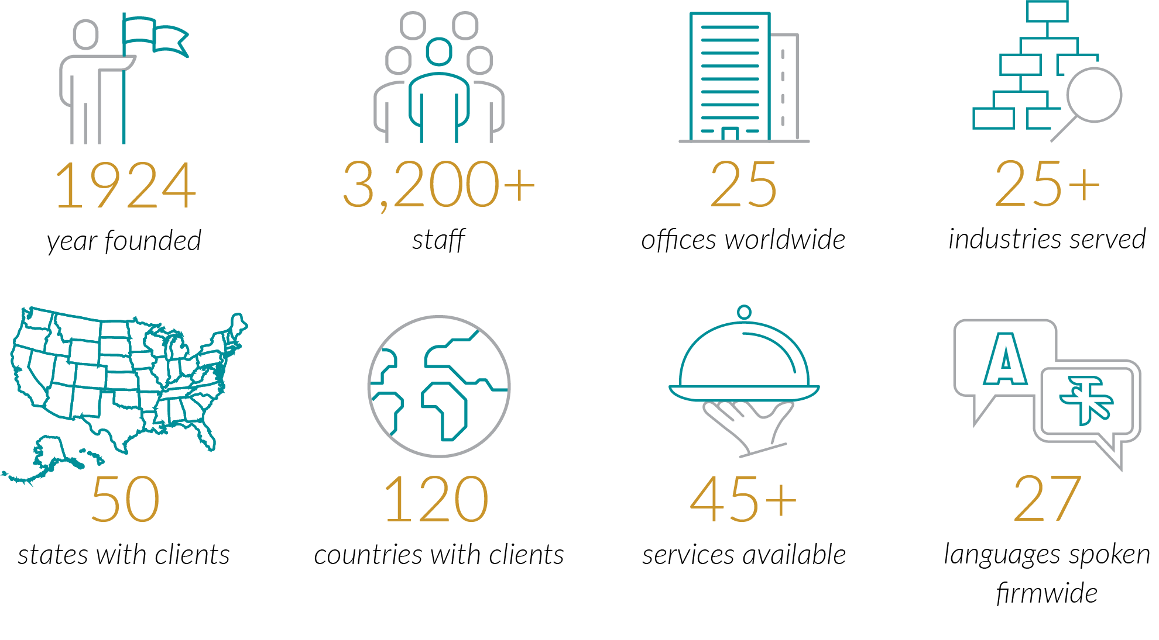

About Plante Moran
Over 100 years of excellence
3,900+
24
27
years on Fortune’s magazine’s “100 Best Companies to Work For”

Slide 3
Governmental Experience That’s Beyond the Expected

Slide 4
Today’s Agenda
Why grant compliance matters
People: Governance and accountability
Process: Lifecycle controls and monitoring
Technology and integration
Key takeaways and practical next steps

Slide 5
Polling Question
When you think about your grants department today, what keeps you up at night the most?
People – staffing, turnover, training, capacity
Processes – policies, handoffs, consistency, controls
Technology – systems, reporting, data, integration
Honestly, all of them!

Slide 6
The Evolving Grant Landscape
Increasing compliance complexity
Consequences of noncompliance
Emphasis on accountability
Need for proactive framework

Slide 7
Common Grant Compliance Missteps
Concentration of Compliance Knowledge
Policy vs. Practice Gap
Reactive Compliance Monitoring
Communication Challenges
Tracking Challenges

Slide 8
People:
Governance and Accountability

Slide 9
Building a Cross-Functional Team
Shared organizational responsibility
Formalized communication channels
Reducing silos and supporting continuity
Leadership and tone at the top

Slide 10
Defining Roles and Responsibilities Across the Grant Lifecycle
Accountability through role clarity
Mapping responsibilities
Use of delegation templates
Training for compliance

Slide 11
Addressing Capacity and Skills Gaps
Recognizing capacity gaps
Targeted training and cross training
Supplementing with external support
Sustaining compliance framework

Slide 12
Processes:
Lifecycle Controls and Monitoring

Slide 13
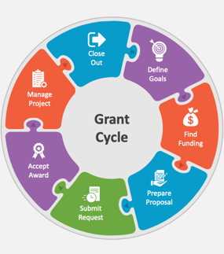
Embedding Compliance Across the Grant Lifecycle
Pre-award compliance
Award acceptance procedures
Implementation monitoring
Reporting and closeout

Slide 14
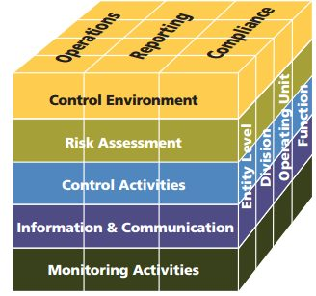
Key Internal Controls that Support Grant Compliance
Proactive risk assessment and management
Strong internal controls across operations
Clear policies, procedures and documentation
Ongoing monitoring and continuous improvement

Slide 15
Ongoing Monitoring and Continuous Improvement
Internal Monitoring
Internal Monitoring Purpose
Risk-based Monitoring
Corrective Action and Follow-up
Continuous Improvement
Exception Identification

Slide 16
Technology and Integration
Using technology to support compliance

Slide 17
Leveraging Accounting Systems for Grant Compliance
Grant-level financial tracking
Standardized account structures
System integration and audit readiness
Technology aligned with the compliance framework

Slide 18
Evaluating Grant Management Software and Data Security
Centralized grant management
Software centralizes tracking of grant terms, deadlines, subrecipients, and compliance documents efficiently
Evaluating the right investment
Deciding on software depends on grant volume, reporting frequency, and departmental collaboration
Data security and access controls
Strong data security policies and user access controls protect sensitive financial and program information
Compliance-driven governance and retention
Clear document retention and data governance policies ensure funder compliance and information protection

Slide 19
Key Takeaways
Integrate people, processes, and technology
Focus on incremental, risk-based improvements
Take practical, achievable next steps

Slide 20
Questions
Amanda Ward, CPA
Amanda.Ward@plantemoran.com

