Slide 1
CGFOA: Two Cash Vehicles: Two Rule Books: Understanding LGIPs and SEC Money Market Funds
Will Goldthwait, Client Portfolio Manager
May 2026
8917603.1.1.AM.INST

Slide 2
Outline:
Disclaimer: The information on this webinar is intended for the confidential use of the CGFOA and State Street and those invited to participate in this webinar. It is not open to the press or the public. Any review, dissemination, distribution or copying of this webinar is strictly prohibited. Comments made by me, Will Goldthwait, are my opinion and not that of State Street. The comments do not constitute investment advice or analytical research and should not be relied upon as such. We are recording this on May 7th, 2026, at 10:00am Mountain Time
8917603.1.1.AM.INST

Slide 3
Outline:
The Fund
Cash Flows
Eligible Investments
Amortized Cost vs. Mark to Market
Attributes
Credit and Risks
Operations
Disclosure and Transparency
8917603.1.1.AM.INST

Slide 4
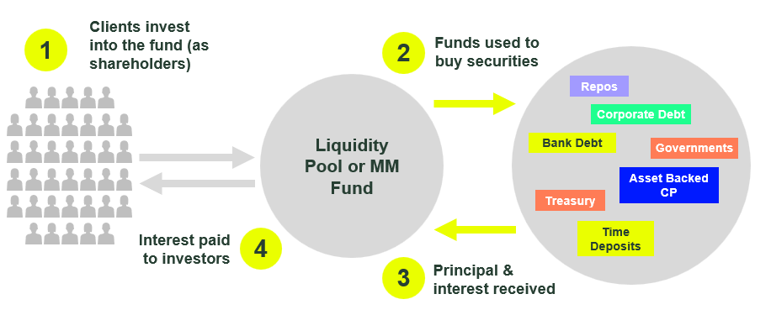
How Does a Liquidity Pool or Money Market Fund Work?
1
Clients invest
into the fund (as shareholders)
2
Funds used to
buy securities
Liquidity Pool or MM Fund
Repos
Corporate Debt
Bank Debt
Governments
Asset Backed
CP
Treasury
Interest paid to investors
4
Time Deposits
3
Principal &
interest received
8917603.1.1.AM.INST

Slide 5
The Volatility of Cash Flows
8917603.1.1.AM.INST

Slide 6
What Can They Invest In?
US Treasury Debt
Government Agency Debt
Commercial Paper (corporate, bank, asset backed)
Certificates of Deposit (bank)
Debentures and Medium-Term Notes (corporate, bank)
Repurchase Agreements (Reverse Repurchase Agreements)
Fixed Rate or Floating Rate – Discounted or Interest Bearing
8917603.1.1.AM.INST

Slide 7
Amortized Cost Accounting
8917603.1.1.AM.INST

Slide 8
What is the yield difference?
8917603.1.1.AM.INST

Slide 9
Attributes – What To Look For
Weighted Average Maturity (WAM)
Weighted Average Life (WAL)
Legal Final Maturity
Concentration and Diversification
Liquidity Levels – Daily, Weekly, Monthly, Quarterly – What Counts Towards Liquidity
Market Rate of Return – 1-day, 7-day, 30-day, 1 year yield
8917603.1.1.AM.INST

Slide 10
GASB 79, SEC 2a-7
Weighted Average Maturity – 60 days
Weighted Average Life – 120 days
Legal Final Maturity – 397 days
Concentration and Diversification – 5% per name
Liquidity Levels – Daily, Weekly, Monthly, Quarterly – What Counts Towards Liquidity – 10%, 25%, 30%, 50%
8917603.1.1.AM.INST

Slide 11

Credit Ratings
Why do funds or pools have Ratings?
How are Funds Rated AAA when all the assets are not?
Are all Credit Rating Agencies the same?
8917603.1.1.AM.INST

Slide 12
What Are Some of The Biggest Risks
Default or Impairment – delay of repayment
Duration – Interest Rate Shock
Banking Crisis (2008)
Liquidity Crisis (2020)
Interest Rate Shock
(2022)
Single Name (2023)
Tariff Shock (2025)
8917603.1.1.AM.INST

Slide 13
Operations
-How to access the fund – direct or portal, manually or electronically
-When does the fund close?
-Are there any limits on redemptions? We don’t like limits
-Is the process easy? We like easy
8917603.1.1.AM.INST

Slide 14
Disclosures and Transparency
Website Disclosure
Regulatory Disclosure
Yield, WAM, WAL, Liquidity, Shareholder Activity
Holdings
Ask Questions!
8917603.1.1.AM.INST

Slide 15
Learning Outcomes
Compare the regulatory frameworks governing LGIPs and SEC registered Money Market Funds, including where state rules align with—or diverge from—SEC requirements.
Understand the post 2016 distinction around credit exposure and amortized cost accounting, and why it matters for Colorado Treasury Professionals.
Evaluate the risk and transparency trade offs between LGIPs and MMFs, including how accounting treatment can affect perceived stability.
Interpret disclosure requirements and practices for each vehicle and identify what information matters most to investors.
Ask the right due diligence questions when assessing LGIPs and MMFs for public sector cash portfolios.
8917603.1.1.AM.INST

Slide 16
Questions:
William_Goldthwait@StateStreet.com
8917603.1.1.AM.INST
SS

Slide 17
Important Disclosures
8917603.1.1.AM.INST
SS

Slide 18
Important Disclosures
For Investment Professional Use Only.
Investing involves risk including the risk of loss of principal. The whole or any part of this work may not be reproduced, copied or transmitted or any of its contents disclosed to third parties without State Street Investment Management’s express written consent. The views expressed in this material are the views of Will Goldthwait, US Fixed Income Client Portfolio Manager and are subject to change based on market and other conditions. This document contains certain statements that may be deemed forward-looking statements. Please note that any such statements are not guarantees of any future performance and actual results or developments may differ materially from those projected.
An investment in the fund or pool is not insured or guaranteed by the Federal Deposit Insurance Corporation or any other government agency. Although the fund seeks to preserve the value of your investment at $1.00 per share, it is possible to lose money by investing in the fund.
The information provided does not constitute investment advice and it should not be relied on as such. It should not be considered a solicitation to buy or an offer to sell a security. It does not take into account any investor's particular investment objectives, strategies, tax status or investment horizon. You should consult your tax and financial advisor. All information is from SSIM unless otherwise noted and has been obtained from sources believed to be reliable, but its accuracy is not guaranteed. There is no representation or warranty as to the current accuracy, reliability or completeness of, nor liability for, decisions based on such information and it should not be relied on as such.
These investments may have difficulty in liquidating an investment position without taking a significant discount from current market value, which can be a significant problem with certain lightly traded securities.
Derivative investments may involve risks such as potential illiquidity of the markets and additional risk of loss of principal.
The trademarks and service marks referenced herein are the property of their respective owners. Third party data providers make no warranties or representations of any kind relating to the accuracy, completeness or timeliness of the data and have no liability for damages of any kind relating to the use of such data.
Web: www.ssga.com
© 2025 State Street Corporation — All Rights Reserved.
Tracking Code: 8917603.1.1.AM.INST
Expiration Date: May 31, 2027
Information Classification: Limited Access
8917603.1.1.AM.INST

