Slide 1

Developing an Effective Framework of Financial Policies
Colorado Government Finance Officers Association – May 14, 2026

Slide 2



Presenter
Scott Catlett
Managing Director – Government Advisory Services
Nashville, TN
17 years as Budget Manager, Assistant Finance Director, and Finance Director for cities
  Populations ranging from 75,000 to 325,000 in urban and suburban settings
  Supervised from 6 to 60 Finance Department staff
  Managed budgets of $200 million to $1.2 billion and investment portfolios of $100 million to $600 million
8 years providing advisory services for state and local governments throughout the US
  Primarily focused on financial management engagements – long-term financial planning, policy and procedures development, and organizational and operational assessments
Adjunct professor teaching public sector financial management and instructor for GFOA and several state affiliates

Slide 3
Focus Areas for Today’s presentation
The Role of Policy in Financial Management
External Influences on Policy
Influences of Best Practices on Policy
Financial Policies Versus Financial Procedures
Key Elements of Critical Policies and Related Questions
Role of Internal Controls in Enforcing Policy

Slide 4
The Role of Policy in Financial Management

Slide 5

Public Sector Financial Management Defined
A system of policies, procedures, systems, and reports that facilitates a better understanding of and helps to ensure the long-term fiscal health of an agency.
Finite resources are available to deliver a myriad of services.
Poor financial management leads to:
  Wasted resources.
  Poor budgetary decisions.
  Unanticipated surpluses and deficits.
  Lack of understanding of future challenges.

Slide 6
The Role of Policy in Financial Management
All of these areas can benefit from thoughtful policy guidance, but first one must understand
What role do external influences play?
What role do best practices play?
What content is appropriate for policy versus procedures?

Slide 7
Examples of Policies and Areas They Govern
POLICY EXAMPLES
AREAS THEY GOVERN
Budget Adoption and Administration
Operating budget
Purchasing and Contracting
Cash Management
Accounting and Financial Reporting
Risk Management
Fund Balance
Capital Asset Management
Debt Management
Investments
Disposition of Surplus Property
Fraud, Waste, and Abuse
Revenue and expenditures
Reserves
Capital improvements
Debt management
Investments
Procurement
Risk management
Position control and authorization
Accounting operations
Year-end close and financial reporting

Slide 8
External Influences on Policy

Slide 9
External Influences on Policy
State Code / Agency Charter
Municipal / Agency Code
Resolutions of the governing body
Policies of the governing body
Administrative policies and procedures

Slide 10
Example: Purchasing Policy
Depending on your agency type:
  Various components of the state law governing public contracts, government operations, water agencies, labor issues, etc. contain requirements that pertain to procurement.
  Some types of charter cities may have requirements in the City Charter that pertain to procurement.
  Ordinances or Resolutions of the governing body may contain procurement-related requirements.
One must have an understanding of the regulatory framework influencing a policy before drafting the policy to ensure that it is fully compliant.

Slide 11
Influences of Best Practices on Policy

Slide 12
What is a Best Practice?
Best Practices identify specific policies and procedures that contribute to improved government management.
They aim to promote and facilitate positive change or recognize excellence rather than merely to codify current accepted practice.
Best Practices are typically codified and tailored to an agency’s specific situations through fiscal policies that guide effective financial management.

Slide 13
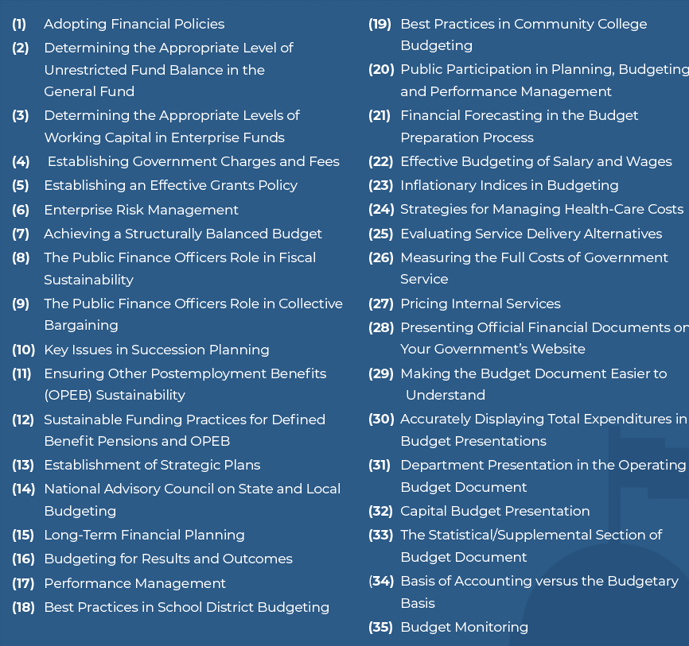
External Influences on Policy
GFOA Best Practices

Slide 14

Example: GFOA Best Practices
Focusing on Budgeting
Strategic Planning and Performance Measures.
Long-Term Financial Planning.
Revenue-Related Best Practices.
Financial Forecasting in the Budget Preparation Process.
Effective Budgeting of Salary and wages.
Achieving a Structurally Balanced Budget.
Public Engagement in the Budget Process.
Budget Monitoring.
And more!

Slide 15

Example of Best Practice Structure
BEST PRACTICES
Effective Budgeting of Salary and Wages
Every government should consider forecasting procedures that would result in more accurate expenditure projections, especially as they relate to personnel.
Key policy statement, followed by explanatory detail covering required policy elements, internal controls, and reporting, which in this case includes:
  Personnel tracking system
  Vacancy adjustments
  Start dates
  Trends
Frozen or eliminated positions
Funded versus unfunded positions
Attrition
Inflation
And more

Slide 16

LEARN MORE
https://www.gfoa.org/best-practices

Slide 17
Financial Policies Versus Financial Procedures

Slide 18

POLICY
PROCEDURE
Policy: High-level and often have a board or council orientation:
  High level policy that is worthy of governing board’s limited time.
  Example: Reserve Policy.
Procedure: Detailed outline of how a policy is to be implemented:
  Is staff oriented.
  Item usually requires management decision making.
  Very detailed outline of how to implement the procedure.
  Example: Cash Handling Procedure.

Slide 19

Why Financial Policies?
Provide a framework within which to conduct financial management.
Ensure that no balls get dropped due to turnover.
If approved by the governing body, reinforce the importance of financial management to constituents.
Not having a policy → is a policy.

Slide 20
Policy and Procedures Hierarchy
Regulatory Framework and Best Practices
Policies of the Governing Body
Organizational Administrative Policies
Administrative Procedures
Department Processes / Desk Procedures

Slide 21
Determining The Right Place for Policies and procedures
It is important that policy is properly located within the hierarchy of possible locations.
Codified or adopted by the governing body.
Approved by the chief executive.
Approved by the applicable department head.
Typically, the higher level the policy, the less detail is included.
Focus on key elements that need that level of policy guidance.
Expand in a lower level of policy.

Slide 22
EXAMPLE: BUDGET ADJUSTMENTS
Governing Body
Establish parameters for budget amendments and transfers requiring governing body approval.
Chief Executive
Develop administrative policies governing the process for requesting budget amendments and transfers.
Department Head
Develop department procedures for processing requests and posting to the financial system.

Slide 23
Example: Purchasing Policy Dollar Thresholds
Governing Body
Establish dollar thresholds for competitive bidding pursuant to state law.
Chief Executive
Develop administrative policies governing the process for managing competitive bidding and awarding a contract.
Department Head
Develop department procedures for managing the advertising process for construction projects.

Slide 24
Example: Utility Accounts Receivable and Billing
Governing Body
Establish parameters for adjustments and write-offs, as well as dollar thresholds requiring approval of chief executive and governing body and appeals.
Chief Executive
Develop administrative policies governing the process for executing adjustments and write-offs relative to approvals, as well as the process for managing appeals.
Department Head
Develop department procedures for tracking and making changes within the billing system.

Slide 25

Updating and Enforcing Policies
It’s not enough just to have policies, they must be followed and be updated / reviewed regularly.
Include penalties for failure to follow appropriate policies (e.g., failure to comply with the procurement
or purchasing card policies will result in progressive discipline).
Incorporate a framework for routine review and update:
  Last updated dates.
  Next review dates.
  Assign an appropriate stakeholder responsibility for updates.

Slide 26

IMPACTS OF THE LACK
OF FINANCIAL POLICIES
Lack of effective financial policies can result in inefficient financial management practices, increased risk, and the misalignment of financial operations with the overall mission of an organization.
At its best, finance works quietly in the background, contributing to the overall service delivery operations for a community.
But when things go wrong, financial administration failures are painfully visible.

Slide 27
Key Elements of Critical Policies and Questions To Ask

Slide 28
Reserve Policies
Issue: Reserve policies either do not exist or reserve levels are not set based on the risk levels impacting the agency.
Potential problems:
  Reserve levels are too high, restricting resources that could be utilized for other purposes.
  Reserve levels are too low, putting the agency at risk in the event of a significant event or financial downturn.
  Reserves are not properly categorized.
  No risk analysis has been performed to determine appropriate reserve levels.

Slide 29
Reserve Policies – Questions To Ask
GFOA General Fund Reserve Calculation Worksheet:
https://www.gfoa.org/materials/general-fund-reserve-calculation-worksheet
Evaluates an agency’s unique risks.
Numeric score places an agency into one of four risk categories:
  Minimal – minimum reserve level of two months of operations.
  Low to moderate – Level at or above the minimum based on peer benchmarking.
  Moderate to high – Higher level with more detailed analysis of risk exposure.
  High – Highest level with detailed analysis of risk exposure.
Local conditions may dictate the need for larger reserves.

Slide 30

USING RESERVES
FOR STABILIZATION
Describe how reserves fit into a “bridging” strategy.
Maintain a credible fund balance policy.
Distinguish between one-time and permanent decreases:
  If one-time, how long will downturn last?
Develop a replenishment strategy:
  How will it be replenished?
  When will it be replenished?

Slide 31
Debt Management Policies
Issue: Debt management practices may be inadequate, and requirements are always changing.
Potential problems:
  Late or unfiled disclosure and arbitrage reports.
  Failure to file material event notices.
  Lost investment earnings potential.
  Bond proceeds on hand for years.
  Inadequate recordkeeping for IRS audit purposes.
  Private activity issues.

Slide 32
Debt Management Policies – Related Questions to Ask
Is there a comprehensive, frequently-updated debt management policy and clear procedures for staff to follow?
Who prepares disclosure and arbitrage reports and material event notices (or are they being prepared) and are they filed timely?
How are bond proceeds and reserve funds invested and how long have bond proceeds been on hand?
How long are records of bond proceeds expenditures kept?
Is a monitoring program in place to check for new private activity uses of bond-financed facilities?

Slide 33

Investment Policies
Issue: Many agencies have out of date investment policies or do not optimally invest funds.
Potential problems:
  Unnecessary policy limitations.
  Inconsistency with state law or current practices.
  Inadequate reporting to Council or Board.
  No cash flow modeling / cash shortages.
  High bank or money market balances.
  Low interest earnings.

Slide 34
Investment Policies – Related Questions to Ask
Who is maintaining the investment policy and when was it last updated?
Are investment reports provided to the Council or Board?
Is cash flow modeling currently utilized to maximize invested funds?
Do cash shortages exist that require external borrowing?
Are bank or money market balances sized appropriately?
Does staff have the expertise and time to manage the portfolio?

Slide 35
Procurement Policies
Issue: Failure to provide adequate oversight to the procurement process can result in violations of the law or internal policies and procedures.
Potential problems:
  Payment of invoices without a purchase order.
  Introduction of opportunities for fraud.
  Issues with adequacy of competitive selection.
  Splitting of purchases / unnecessarily low bid limits.
  Inadequate tracking of change orders.
  Exceeding Council or Board-authorized contract or change order limitations.

Slide 36
Procurement Policies – Related Questions to Ask
Are procurement policies out of date? What do the departments think?
Is bid splitting happening and/or are bid limits too low?
Is a process in place to ensure that departments are really trying to obtain competitive quotes?
Are purchase orders always required other than for specific types of purchases?
Are change orders tracked by Finance to ensure accurate encumbrances?
Is a process in place to monitor spending limitations imposed by the Council or Board?

Slide 37
Budget Administration Policies
Issue: Budget processes may be informal, inadequate, and/or inconsistent with regulatory requirements.
Potential problems:
  Budget transfers approved without proper authorization.
  Appropriations approved without proper authorization.
  Inadequate procedures for the management of budget carryovers / rebudgeting.
  Inadequate processes for evaluating budget enhancements.

Slide 38
Budget Administration Policies – Related Questions to Ask
Is the budget process well understood, formalized, and appropriate for the size and complexity of the agency?
Is a framework in place to evaluate requests for additional funding or budget transfers?
Are appropriate controls in place to prevent unauthorized appropriations or transfers?
Is a formalized process in place for the evaluation and approval of budget carryovers or rebudgeting?

Slide 39

Cash Management Policies
Issue: Controls over cash management may be inadequate or inconsistent across the agency.
Potential problems:
  Differing procedures at various points of payment.
  Inadequate review and approval of cash receipts reporting.
  Infrequent transfers, inadequate storage, or inappropriate deposit mechanisms for cash on hand.

Slide 40
Cash Management Policies – Related Questions to ASk
Are cash management procedures standardized throughout the organization?
Is Finance ultimately responsible for and approving any variances in these procedures?
Is cash transported, stored, and tracked appropriately?
Are appropriate levels of review in place to ensure control over cash on hand on a daily basis?

Slide 41
Capital Asset and Inventory Policies
Issue: Capital assets may not be properly tracked or coded upon purchase or inventory may not be properly controlled.
Potential problems:
  Capital assets are recorded in operating expenditure accounts.
  Capital purchases are not adequately tracked and are missed.
  Inventory is not tracked or is expensed upon purchase.
  Inventory counts are infrequent and discrepancies are not reconciled.
  Asset disposal practices are not centralized.

Slide 42
Capital Asset and Inventory Policies – Related Questions to Ask
Does the financial system include a mechanism to properly track and identify capital purchases at the time of purchase?
Is the disposal of capital assets centrally managed and monitored?
Is appropriate control over inventory in place, are counts undertaken regularly, and are discrepancies reconciled?
Are valuable inventory items tracked with appropriate controls over their use?

Slide 43
Long-Term Financial Planning Policies
Issue: Long-term financial planning is not a priority or is conducted irregularly without significant updates considered during the budget process.
Potential problems:
  The impact of current financial decisions on the long-term financial plan is not considered.
  The long-term financial plan is infrequently updated and only when a triggering event occurs such as the issuance of debt.
  The long-term financial plan is an internal staff document.

Slide 44
Long-Term Financial Planning Policies – Related Question to Ask
Is the long-term financial plan regularly updated and presented to the governing body?
Are the impacts of budgetary decisions on the long-term financial plan considered as a matter of routine?
Is the complexity and scope of the long-term financial plan appropriate for the size and complexity of the agency?
Are subject matter experts in departments a part of the long-term financial planning process?

Slide 45
Fraud, Waste, and Abuse Policies
Issue: The agency does not prioritize a culture of preventive controls relative to fraud, waste, and abuse.
Potential problems:
  Internal audits, spot counts, etc. are not regularly conducted.
  A fraud hotline or other reporting mechanism is not in place.
  A lack of appropriate definitions for what constitutes fraud, waste, or abuse results in grey areas.
  A lack of procurement and expenditure controls prevents detection of related fraud.

Slide 46
Fraud, Waste, and Abuse Policies – Related Questions to Ask
Does the governing body prioritize fraud, waste, and abuse detection and mitigation?
Does management emphasize the importance of reporting and detection?
Is a fraud hotline or other reporting mechanism in place?
Are definitions of what constitutes fraud, waste, and abuse well understood by employees?
Are random checks, audits, etc. a part of routine business?

Slide 47
Position Control Policies
Issue: Information provided by the HR Department is not sufficient or timely and impacts payroll operations.
Potential problems:
  Employees are paid after they have separated or are placed on leave.
  Merit increases, cost of living adjustments, or benefits adjustments are not processed timely.
  Employees are hired for which there are no funds budgeted.
  Retired annuitants or temporary employees are not properly tracked or reported to the pension system.
  Employee pay is inconsistent with approved schedules and/or is not periodically reviewed.

Slide 48
Position Control Policies – Related Questions to Ask
Is Finance part of the employee separation or leave workflow?
Do current procedures ensure that changes in salaries and benefits are processed timely by payroll?
Is available budget checked prior to initiating recruitments?
Are retired annuitants and temporary employees tracked to ensure compliance with pension plan regulations?
Are any employees paid more or less than per authorized salary schedules?
Are additional pay amounts reviewed periodically and checked by managers with knowledge of the positions?

Slide 49
Role of Internal Controls in Enforcing Policy

Slide 50
What are Internal Controls? The Technical Answer…
Internal control is a process effected by an agency’s oversight body, management, and other key personnel that provides reasonable assurance of the achievement of objectives related to operations, reporting, and compliance.

Slide 51
No, Really…What are Internal Controls?
At its simplest, internal control is a process.
The goal of this process is to provide reasonable assurance (not absolute assurance) that we can achieve our objectives related to operations, reporting, and compliance (and fraud prevention).
Internal controls are tools to help management avoid problems like misappropriation of funds, non-compliance with rules and laws, operational failures, and inaccurate financial reporting.

Slide 52
Organizational Perception of Internal Controls
Some organizations treat internal controls as a tedious task that sits at the bottom of the to-do list.
Internal controls are a powerful tool to protect an organization’s interests and assets.
Effective internal controls help organizations ensure compliance with policies and procedures.
A well-designed internal control system can lead to more effective and efficient operations.
Allows organizations to identify and improve upon duplicate or unnecessary procedures and/or weaknesses in their systems and processes.
Organizations have internal controls to comply with applicable laws and regulations:
  Being on the wrong side of laws and regulations can be very expensive for organizations, both in terms of fines and judgments and in negative hits to the organization’s reputation.

Slide 53
Policy-Related Internal Control Best Practices
Conduct an annual review of controls, guidance, procedural documentation and process maps outlined in policies and procedures.
Ensure and regularly evaluate strict processes surrounding delegated expenditure authority.
Conduct an annual review of policies and procedures and develop related training materials.
Test controls frequently to ensure they are working as designed and adjust them based on results.
Automate controls to ensure compliance with policy and procedures when and where possible.

Slide 54
Policy-Related Internal Control Examples
Cash Management
Steps to prevent losses of funds which might arise from fraud, employee error, and misrepresentation by third parties, or imprudent actions by employees of the unit of local government.
Investments
Chart of investment activities and discussion of each step and the risks involved.
Authorized individuals to initiate trades or transfers and related processes.

Slide 55
Policy-Related Internal Control Examples
Budget and Financial Reporting
Budget transfers properly recorded and approved.
Transactions recorded in accordance with applicable policies and rules.
Transactions are carried out by the appropriate authorized individuals within the entity.
Grants
Grant funds utilized in compliance with applicable laws, regulations, terms, etc.
Assets purchased/constructed/developed with grant funds are safeguarded properly.
Financial reports required by grants are accurate and timely.

Slide 56
Get Started on Your Policy, Procedures, and Internal Controls Evaluation and Updates

Slide 57
What Next?
Consult the GFOA best practices library.
Determine what the right balance between policy, procedures, and flexibility is for your agency.
Seek example policies and procedures from organizations with a strong policy framework.
Use your professional network, and engage experts when necessary or beneficial.
Develop a standard framework for your policy and procedures library.
Start with what’s most important, and build on that foundation as time permits.

Slide 58


Contact Information
QUESTIONS?
Scott Catlett
Managing Director – Government Advisory Services
Eide Bailly, LLP
775-337-3941
Email: scatlett@eidebailly.com
This presentation is presented with the understanding that the information contained does not constitute legal, accounting, or other professional advice. It is not intended to be responsive to any individual situation or concerns, as the contents of this presentation are intended for general information purposes only. Viewers are urged not to act upon the information contained in this presentation without first consulting competent legal, accounting, or other professional advice regarding implications of a particular factual situation. Questions and additional information can be submitted to your Eide Bailly representative, or to the presenter of this session.

