Slide 1


Arbitrage Compliance Trends & Topics
Matt Collins, Vice President
Arbitrage Compliance Specialists, Inc.
Prepared for:
Colorado Government Finance Officers Association
May 22, 2025

Slide 2

Your Arbitrage Expert
Matt Collins, Vice President
Arbitrage Compliance Specialists, Inc.
Matt@rebatebyacs.com
(303)867-7538
12 Years of arbitrage rebate experience, 17 years of financial services experience. Provides arbitrage consulting services for over 340 Cities, Counties and School Districts across the Country. ACS completes over 2,500 arbitrage calculations annually.

Slide 3
Learning Objectives
Arbitrage Rebate Key Concepts & Terminology:
What is Arbitrage Rebate?
Funds and Proceeds Subject to Arbitrage Rules
Exceptions to Arbitrage Rebate – Spending Exceptions (MAY BE USEFUL AGAIN!)
Yield Restriction (MANY YIELD RESTRICTION PAYMENTS HAPPENING NOW!)
Reporting Requirements
Application to Current Market Trends
Managing Rebate & Yield Restriction Payments
Current Trends

Slide 4

Arbitrage Rebate
Arbitrage rebate is a federal tax law requirement - §148 of the Internal Revenue Code.
Applicable to every tax-exempt borrowing unless exceptions apply.
Established by Congress with the intention to limit use of tax-exempt proceeds from:
    Issuance of more bonds than necessary
    Issuance of bonds earlier than necessary
    Prevention of bonds from remaining outstanding longer than necessary
Borrow what you need, when you need it, and for an appropriate duration based on financing needs.

Slide 5
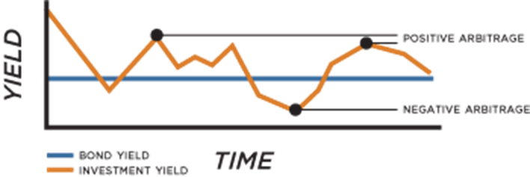
Arbitrage Rebate
Definition of Arbitrage
As of any computation date, the arbitrage rebate amount for an issue is the excess of the future value of all receipts on non-purpose investments over the future value of all payments on non-purpose investments. These rules have been in place for all tax-advantaged bonds since the Tax Reform Act of 1986.
In other words, arbitrage is the profit made from investing tax-exempt bond proceeds in taxable investments. Arbitrage rebate limits those profits not to exceed the “arbitrage yield” or bond yield for each bond issuance.
Measured on an issue-by-issue basis
  Positive Arbitrage
  Negative Arbitrage

Slide 6
Funds Subject to Arbitrage Rebate:
Transferred Proceeds
Escrow Fund
Replacement Proceeds
Project Fund
Sinking Fund
Debt Service Fund
  Project Funds
  Capitalized Interest Funds
  Costs of Issuance Funds
  Reserve Funds
  Escrow Funds
  Transferred Proceeds
  Replacement Proceeds
    Debt Service Funds (that fail “bona fide” test)
    Reserve Funds
    Escrow Funds
    Transferred Proceeds (unspend proceeds of refunded bonds)
  Disposition Proceeds
Reserve Fund
Investment Proceeds
COI Fund

Slide 7
Exceptions to Arbitrage
Allow issuers to exempt funds or an entire bond from arbitrage rules
Bond Level:
Small Issuer Exception
Fund Level:
Spending Exceptions (6 month, 18 month, 24 month)
Bona Fide Debt Service Fund Exception
Investing/purchase of certain investments
Available Project Proceeds Exception (Tax Credit Bonds)
Sinking Fund Reserve Exception (Tax Credit Bonds)

Slide 8
Small Issuer Exception to Arbitrage Rebate
Bond Level Exemption
Issue $ Limits:
$5 million of governmental bonds for municipalities
$15 million per calendar year for public school construction
Requirements:
Must be governmental bonds (not private activity)
Issuer must have general taxing powers
At least 95% must be used for local governmental activities
Refunding considerations (these are important!)
Current refunding exclusions
Refunding of prior bonds (subject to arbitrage rebate, weighted average maturity, maturity dates)

Slide 9
Spending Exceptions to Arbitrage Rebate
6-month, 18-month, and 24-month Spending Exceptions
6-month: All proceeds spent by 6 months.
18-month:
15% in 6 months
60% in 12 months
100% in 18 months
24-month (Construction Only)
10% in 6 months
45% in 12 months
75% in 18 months
100% in 24 months

Slide 10

Debt Service Fund Exemption
“Replacement Proceeds”
Debt Service Funds (although not funded with bond proceeds, can be subject to the arbitrage rules unless the fund meets a “bona-fide” exemption.
  Used primarily to achieve a proper matching of revenues with debt service payments and is depleted annually to a reasonable carryover amount:
        The earnings on the fund for the preceding year, or
        1/12 of the principal and interest payments on the issue for the preceding bond year.

Slide 11
Investment Exemptions to Arbitrage Rebate
Certain types of investments are also exempt from arbitrage
Investments Purchased with Bond Proceeds Exempt from Arbitrage:
Non-AMT Tax-Exempt Municipal Bonds,
Demand Deposit SLGS
Tax-Exempt Muni Bonds:
Any interest received is exempt from the arbitrage rules.
Can help lock in yields especially if rates decline.
Liquidity concerns.
Demand Deposit SLGS (not to be confused with time deposit SLGS):
Any interest received is exempt from the arbitrage rules.
Provide greater liquidity than tax-exempt muni’s.
Evaluate on a bond-by-bond basis. (Depends on bond yields, expected spend-down and current slgs rates.
Note: ACS is not a registered investment advisor, the facts presented above are intended to outline certain investments that are exempt from the arbitrage and yield restriction regulations. Each issuer should consult with their investment advisor (if any) concerning any specific investments contemplated to be purchased with bond proceeds. ACS is also available to be a resource for issuers should any arbitrage-related questions arise.

Slide 12

What is Yield Restriction?
Yield Restriction is the profit made from investing bond proceeds in higher yielding taxable investments above a materially higher yield after a designated temporary period and above the minor portion.
Enacted prior to arbitrage rebate in 1969, rules still apply to tax-exempt borrowings.

Slide 13

Yield Restriction vs. Arbitrage Rebate
Similar to arbitrage rebate, restriction against investing above arbitrage yield.
  Arbitrage Rebate = Entire “Pie”
  Yield Restriction = Parts of the “Pie”
Enacted prior to arbitrage rebate in 1969, rules still apply to tax-exempt borrowings.
Exceptions apply:
  Temporary Periods
  Minor Portion
  “Reasonably Required” reserve fund(s)

Slide 14

Yield Restriction: Temporary Period
A Temporary Period defines the period for unrestricted investment per fund/proceed type. The most common Temporary Period is the 3 year period for Project Funds.
Fund Type | Temporary Period(s) Available
Project | 3 or 5 Years
Cost of Issuance | 13 Months
Current or Advanced refunding (Adv. is defined as a refunding that takes place after 90 days) | 30 or 90 Days
Replacement Proceeds (Typically Debt Service, Pledged and Unreasonable Reserve) | 30 Days
Bond Fide Debt Service | 13 Months
Reasonable Required Reserve | None
Minor Portion (Aggregate amount not to exceed the lesser of 5% of sales proceeds or $100,000) | None

Slide 15
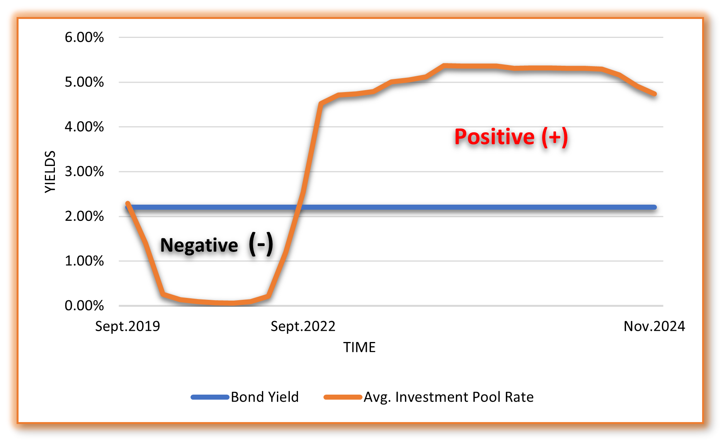
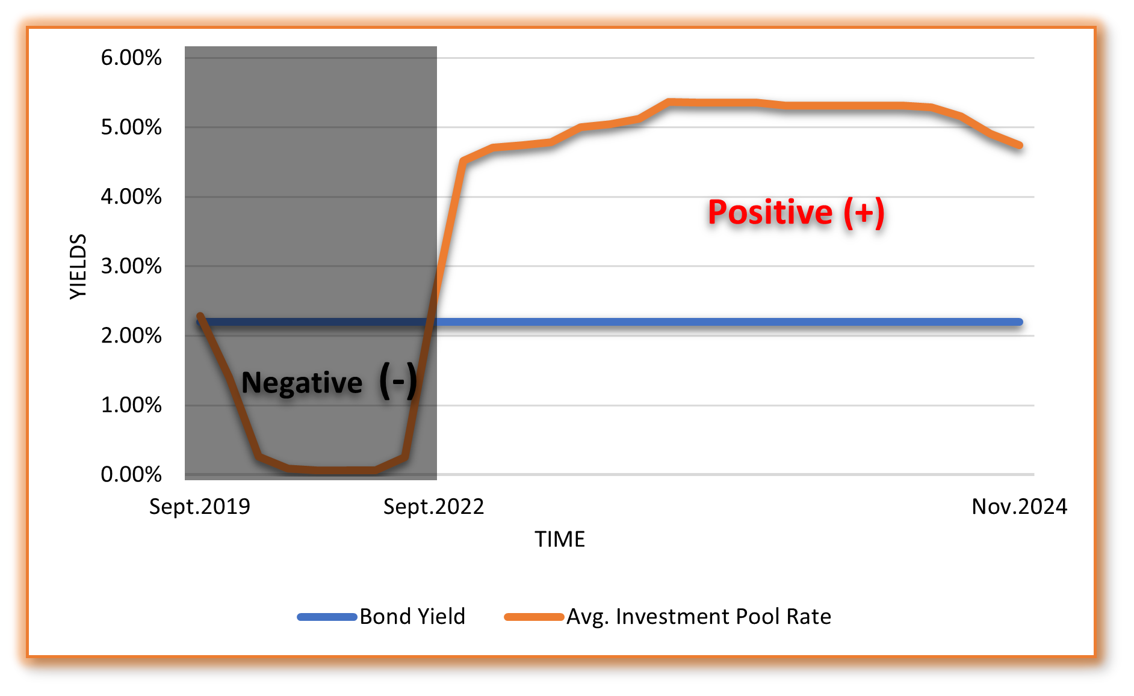
Yield Restriction vs. arbitrage rebate
Remember the earlier slide with the arbitrage graph? The bond did not owe arbitrage rebate. But what about yield restriction?
Project yield restriction starts if funds remain after year three (remember the temporary period). Positive yield restriction is occurring for many 2019 & 2020 bonds where funds were not spent after year three.

Slide 16
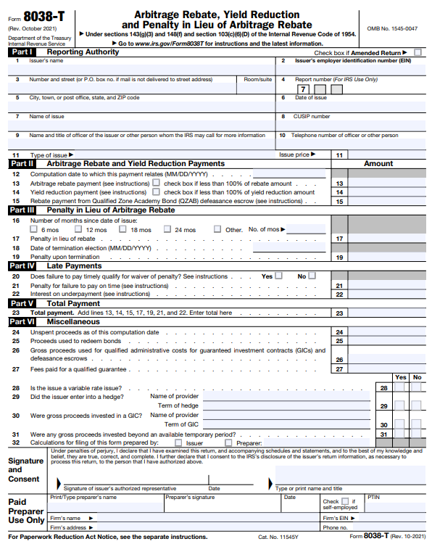
What are the Minimum Reporting Requirements?
Arbitrage Rebate & Yield Restriction
Any arbitrage or yield restriction payments must be made no later than 60 days after the computation date.
  Computation Date: No later than 5-years after the issue date and every five years thereafter until the final maturity date
  Payment(s): 90% or 100%
Submit check and IRS Form 8038-T.
Do not send calculations!
No filing requirement if no payment is due.

Slide 17

Filing Requirements
What if payments are not made on time?
  Subject to interest and penalties:
    50% of rebate amount, plus interest
    Interest computed at underpayment rate
  Late payment explanation required
  IRS can consider waiving penalty (excluding interest) if:
      Liability plus late interest is paid within 180 days after the date the failure was discovered
      Bonds are not under audit
      Late payment was not caused by “willful neglect”

Slide 18
What if Issuers Owe Rebate or YR?
Draft effective policies and procedures that fit your Policies:
1
Helps identify potential problems early
Promotes awareness throughout the department.
In certain situations, may provide advantages when dealing with the IRS.
Create listing of key bond facts:
2
Borrowing Cost (Bond Yield)
Issuance Date
Maturity Date
5th Year Payment Dates (Due within 60 days of 5th Year)
Accrued Liabilities but not yet paid (list in Annual Report)
Read through policies annually, and create and execute due diligence checklists.
3

Slide 19
What if Issuers Owe Rebate or YR?
Arbitrage Report - 60 Days to complete and make payment to the IRS and covers 5 Years
Personal Taxes – 105 Days to complete and make payment to the IRS and covers 1 Year
Arbitrage Rebate and Yield Restriction Calculations involve working with:
  Investments
  General and Subsidiary Ledgers
  Annual Comprehensive Financial Report
  Official Statement, Tax Certificate, Form 8038-G, Escrow Verification
  Tax Code Interpretation
Can include over thousands of pages of documentation!

Slide 20

What if Issuers Owe Rebate or YR?
What should I do if we are earning positive arbitrage?
The tax code does not prevent issuers from earning positive arbitrage, issuers are still compliant with the tax code if any positive arbitrage payment is made within 60-days after the 5-year anniversary date of the issue.
Every issuer’s tolerance for risk is different, but if issuers plan ahead for positive arbitrage and make payments on time, then you are just maximizing interest earnings allowed under the federal tax code.
Trying to blend down investment yields to not “owe” arbitrage can leave potential earnings on the table.
If positive arbitrage is being earned, we advise issuers to complete annual calculations and set aside funds to make future rebate payments that may be due
There are also options to for “spending exceptions” that issuers can try to meet that allow all earnings to be retained. Additionally, certain investments can be purchased with bond proceeds that are exempt from the arbitrage regulations.

Slide 21
Current Arbitrage Trends
Are we the only issuer earning arbitrage? (No)
Why are we here?
  Higer investment rates
  Lower Borrowing Rates
Recent Trends in Investment Rates and its Effect on Arbitrage:
  Currently, a majority of 2022, 2023 & 2024 bonds are earning arbitrage (however, doesn’t mean that there is a possibility for older bonds to start “flipping” into positive arbitrage liabilities, or that all 2022 – 2024 bonds are earning positive arbitrage). Each financing has different elements that can be unique to each arbitrage rebate calculation.

Slide 22
Current Trends:
Arbitrage Rebate & Yield Restriction Payments & Liability Accruals
Report Type | Report Periods | ACS # of Reports Completed | Number of Payments | Liabilities (to be paid)
Arbitrage Rebate | 2009 to 2019 | 25,208 | 27 | N/A
Arbitrage Rebate | 2020 to Current | 11,301 | 72 | 456*
Total Paid or Accrued Liability Amounts (Rebate) | $354,192,334
Project Yield Restriction | 2009 to 2019 | See above | 9 | N/A
Project Yield Restriction | 2020 to Current | See above | 131 | 153*
Total Paid or Accrued Liability Amounts (YR) | $46,336,677
ACS completes approximately 2,500 arbitrage rebate & yield restriction calculations per year.
*Note: Difficult to access true number, since many issuers do not complete interim reports.

Slide 23

Questions?
Arbitrage Compliance Specialists, Inc.
(303) 867-7538
matt@rebatebyacs.com

