Slide 1

GASB Examples
July 31, 2026

Slide 3






Presenters
Janeen Hathcock
David Peaden
Shelley Goodrich
Partner
Partner
Director
John Hagen
Michaelyn Roelle-McGrand
Kyle Bartle
Senior Manager
Manager
Senior Manager

Slide 4
Agenda Overview
Accounting Standards Update
GASB 103 – Financial Reporting Model Improvements
GASB 104 – Disclosure of Certain Capital Assets
GASB 105 – Subsequent Events

Slide 5
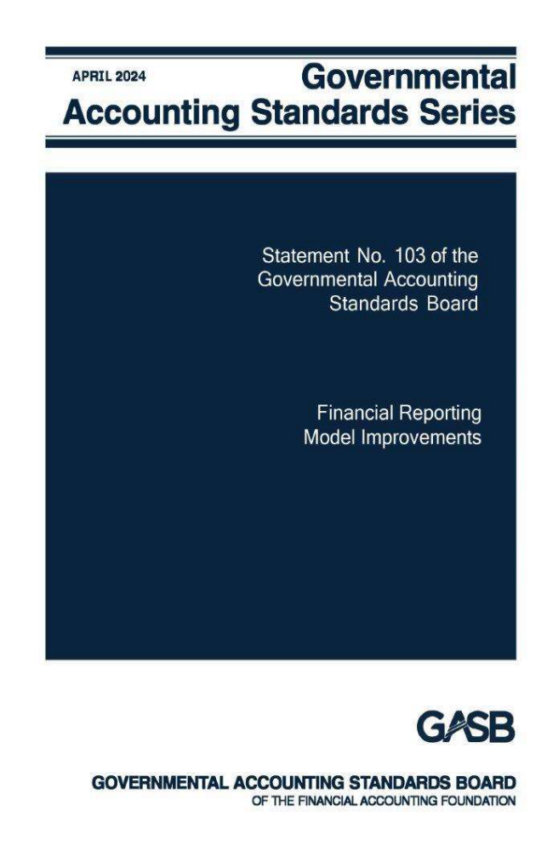
GASB 103, Financial Reporting Model Improvements

Slide 6
MD&A – Five Sections
Overview of the financial statements
Financial summary
Detailed analyses
Significant Capital Asset and Long-Term Financing Activity
Currently Known Facts, Decisions, or Conditions

Slide 7

MD&A – Reminders
DO explain current year balances and WHY the results changed from the prior year; emphasis on the current year.
DO NOT explain the fact that increases/decreases occurred.
Remove duplications and avoid “boilerplate” language.
Focus information on the primary government and use professional judgment as to whether component unit activity is addressed.
Notes:
GFOA comments being received regarding these changes – this is on their radar

Slide 8

MD&A –
Detailed Analysis
Detailed analyses:
  Primary government’s financial position and results of operations—both governmental and business-type activities:
    In addition to amounts/percent of change, explain WHY change occurred.
  Fund balance or net position and results of operations of each major fund (nonmajor funds excluded):
    In addition to amounts/percent of change, explain WHY change occurred.
Notes:
Point out illustration in the standard

Slide 9
MD&A – Significant Capital Asset and Long-term Financing Activity
Capital Asset Activity
Include intangible capital assets.
Discussion of significant additions and disposals.
Discussion of significant policy changes and economic factors.
Avoid duplication between the analyses and this component.
Long-term Financing Activity
Includes debt, leases, PPPs, and SBITAs.
Discuss new agreements, changes to credit rating, debt limit.
Discussion of significant policy changes and economic factors.
Avoid duplication between the analyses and this component.

Slide 10
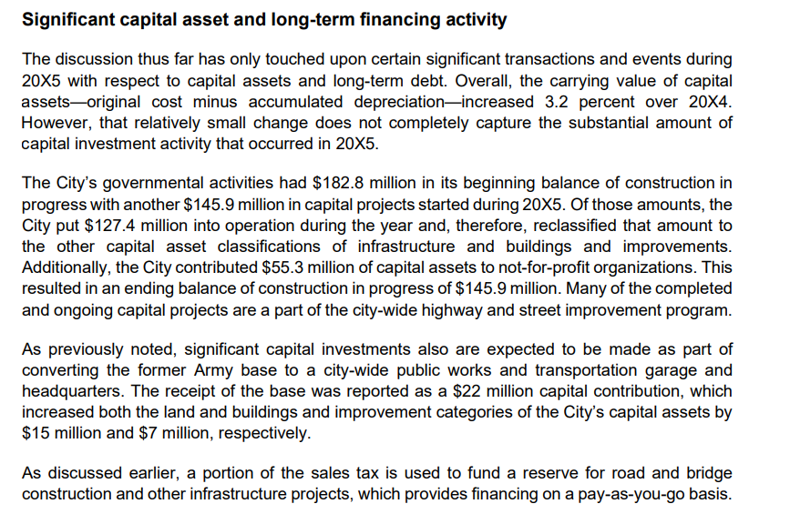
Notes:
You can see it tries not to duplicate explanations

Slide 11
MD&A – Currently Known Facts, Decisions, and Conditions
Include a description of currently known facts, decisions, and conditions that are expected to have a significant effect on financial position or results of operations in the subsequent year. Examples could include:
  Trends in relevant economic and demographic data.
  Factors used to develop the subsequent year’s budget:
    Those affecting revenues available for appropriation, e.g., changes in rates and bases of activity.
    Those affecting planned spending, e.g. inflation, labor contracts, changes in programs.
  Expected changes in budgetary net position or fund balance.
  Actions government has taken related to PEB, capital plans, leases, PPPs, SBITAs (long-term items).
  Actions other parties have taken, such as new laws or regulations.

Slide 12
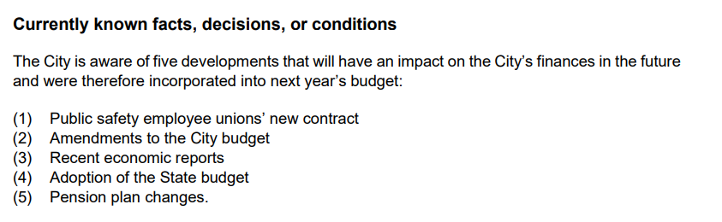
Notes:
Examples in the Illustration – continues to provide additional paragraphs describing each one of these points.

Slide 13
Proprietary Funds – Operating and Nonoperating
Separate presentation of operating and nonoperating revenues and expenses:
Operating
Activities other than nonoperating activities
Nonoperating
Subsidies received and provided
Revenues and expenses of financing
Resources from the disposal of capital assets and inventory
Investment income and expenses
Contributions to permanent and term endowments

Slide 14
Operating to Nonoperating (vice versa) Examples
Core shift in thinking
Under GASB 103:
  Operating = revenues/expenses arising from exchange or exchange‑like transactions that are central to the fund’s principal ongoing operations:
    Nonoperating = activities that are financing, subsidy‑driven, incidental, or peripheral, even if they occur regularly.
This is why items that used to feel “routine” may move to nonoperating.
Before breaking it out by government type, these changes show up across all proprietary funds:
  Common items moving from Operating → Nonoperating:
    Capital contributions (including developer contributions).
    Operating subsidies from another government or the general fund.
    Certain grants that do not meet exchange‑like criteria.
    Transfers in intended to support operations.
  Common items moving from Nonoperating → Operating:
    Fees and charges that are integral to delivering the service, even if historically shown as nonoperating.
    Penalties or ancillary charges directly tied to service delivery (fact‑dependent).
These shifts are explicitly expected under GASB 103 due to the new definitions.

Slide 15
Operating to Nonoperating (vice versa) Examples
Cities:
  Operating → Nonoperating:
    General fund operating subsidies to water or sewer funds.
      Even if recurring, they are financing in nature, not exchange‑based.
    Capital grants for system expansion (e.g., EPA or state revolving fund grants).
    Developer impact fees restricted to capital purposes.
  Nonoperating → Operating:
    Connection fees if they are exchange‑like and part of the utility’s normal service model (not capital‑restricted).
    Airport landing fees and terminal rents that were previously lumped into nonoperating but are core to airport operations.
Why this matters: Cities often used operating income as a rate‑setting metric. GASB 103 will frequently lower operating income even though cash flows are unchanged.

Slide 16
Operating to Nonoperating (vice versa) Examples
Counties:
  Operating → Nonoperating:
    County general fund support for hospitals or transit systems.
    Public health or indigent care subsidies.
    Grants that do not require proportional exchange of value.
  Nonoperating → Operating:
    Patient service revenues previously netted or misclassified.
    Transit farebox revenues that may have been treated as incidental.
Counties with hospital or transit operations will often see operating margins compress under GASB 103.

Slide 17
Operating to Nonoperating (vice versa) Examples
States:
  Operating → Nonoperating:
    Legislative appropriations supporting toll roads or transit authorities.
    State subsidy payments to higher‑education auxiliaries.
    Capital appropriations for enterprise expansion.
  Nonoperating → Operating:
    Lottery ticket sales (if reported as proprietary) clearly qualify as operating under the exchange‑like definition.
    Auxiliary student fees directly tied to services (housing, dining).
States are one area where GASB 103 significantly improves comparability across agencies.

Slide 18
Operating to Nonoperating (vice versa) Examples
Special districts:
  Operating → Nonoperating:
    Member government contributions.
    Formula‑based operating subsidies.
    Capital grants and pass‑through funding.
  Nonoperating → Operating:
    Usage‑based charges that had been conservatively classified as nonoperating.
    Availability payments if structured as exchange‑like service contracts.
Special districts are among the most affected, because many relied heavily on subsidies while still presenting strong “operating” results under old practice.

Slide 19
Operating to Nonoperating (vice versa) Examples
School Districts:
  Operating → Nonoperating:
    General fund transfers supporting food service deficits.
    Federal reimbursement subsidies that are not exchange‑like.
    State meal program supplements.
  Nonoperating → Operating:
    Student meal charges.
    Program participation fees when directly tied to service delivery.
For districts, GASB 103 typically makes food service operations appear less self‑supporting at the operating level.

Slide 20
WARNING –Relation to GASB 9
Operating Revenue ≠ Cash from Operations
Enterprise Funds – Statement of Cash Flows (GASB Statement No. 9)
Key Reminder:
  Just because a transaction is reported as operating revenue in an enterprise fund does not mean it represents cash provided by operating activities on the Statement of Cash Flows.
Why This Happens Under GASB:
  GASB Statement No. 9 requires cash flow classification based on the nature of the cash transaction, not the income statement classification. Some items affect operating income but do not involve operating cash receipts in the period.
Common Examples:
  Accrued operating revenues increase operating income but have no current‑period cash impact.
  Noncash transactions (e.g., lease or SBITA inception) affect revenues or expenses but are excluded from operating cash flows.
  Timing differences between revenue recognition and cash collection.
Bottom Line:
  The Statement of Revenues, Expenses, and Changes in Net Position measures economic performance —
  the Statement of Cash Flows explains liquidity and cash activity.
Notes:
This is a frequent source of confusion for governing boards — especially when an enterprise fund reports positive operating income but negative operating cash flows. GASB is intentionally distinguishing economic results from cash liquidity.

Slide 21
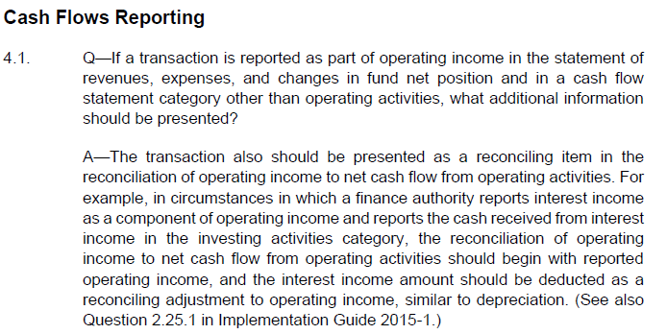
WARNING – Relation to GASB 9
Related question from Implementation Guide No. 2025-1:

Slide 22
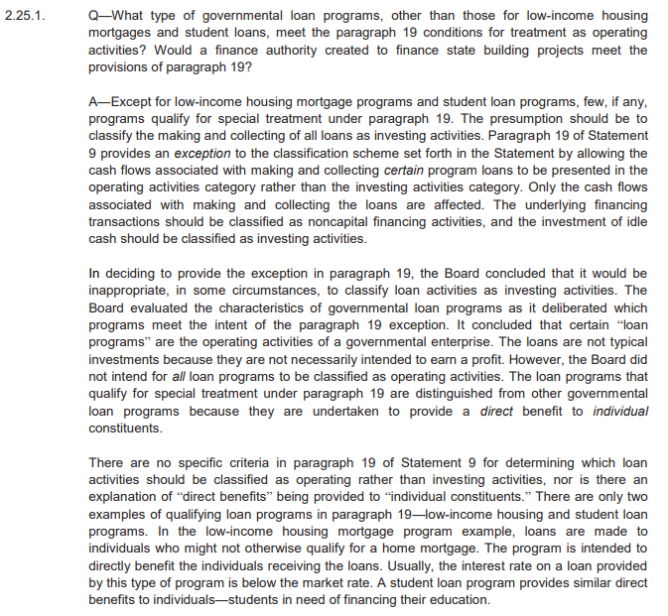
WARNING – Relation to GASB 9
Related question from Implementation Guide No. 2015-1:
  Cash flow presentation as operating or not for BTA where loans are the principal activity?
    Operating activity for low-income housing and student loan programs where individuals directly benefit.
    For all other entities, the financing transactions are noncapital financing, while the investment of idle cash is an investing activity.

Slide 23
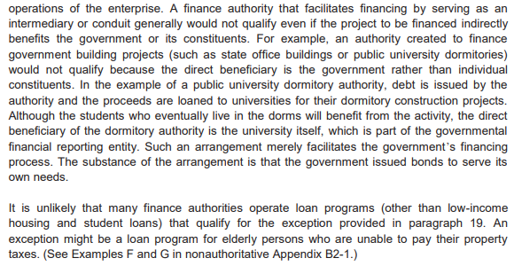
WARNING – Relation to GASB 9
Related question from Implementation Guide No. 2015-1

Slide 24
Proprietary Funds – Subsidies
Add a new subtotal for operating income (loss) and noncapital subsidies
Subsidies
Resources received from another party or fund (1) for which the proprietary fund does not provide goods and services to the other party or fund and (2) that directly or indirectly keep the proprietary fund’s current or future fees and charges lower than they would be otherwise.
Resources provided to another party or fund (1) for which the other party or fund does not provide goods and services to the proprietary fund and (2) that are recoverable through the proprietary fund’s current or future pricing policies.
All other transfers.

Slide 25
Subsidy Examples
Cities:
  City pays a transit authority or nonprofit operator to offset operating deficits.
  A city’s General Fund provides annual cash support to its water or electric utility to keep rates affordable.
  City makes periodic payments to a utility to stabilize rates during revenue shortfalls (e.g., drought or economic downturn).
  City receives funds for transit services from the State or federal government.
Counties:
  County provides operating support payments to a county‑owned hospital.
  County funds cover operating losses of a county airport or transit system.
  County provides unrestricted funding to a legally separate but blended entity (e.g., economic development corporation).
  County receives funds for transit services from the State or federal government.
Notes:
Key points to remember -

Slide 26
Subsidy Examples
State:
  Annual operating aid to local transit systems.
  State provides unrestricted operating appropriations to universities.
  State funds provided to stabilize an insurance pool or utility enterprise.
School District:
  General Fund transfers cash to the school nutrition / food service enterprise fund to cover operating deficits.
  District operates a fee‑based preschool or daycare.
  General Fund provides annual operating support to keep fees affordable.
  School district provides unrestricted operating support to a legally separate education foundation or charter school (component unit).
  Funds are not tied to specific services rendered.
  State provides funds specifically to offset operating losses of a district‑run transit, broadband, or utility‑type program.
  District reports the activity as an enterprise fund.
Notes:
Key points to remember -

Slide 27
Subsidies – Implementation Guide Update 2026 (Proposed)
Deadline for comment submission was 4/27/26.
The exposure draft contains subsidy-specific questions and one amended question regarding subsidies. The proposed questions include the following:
  Supplemental Payments
  Donations to Higher Education
  Published Tuition Rates
  Research Grants
  Taxes Imposed by a BTA
  Passenger Facility Charges
  Subsidies other than Noncapital
  Capital Subsidies
The amended question pertains to classification of subsidy used for capital assets but not limited by the provider for that purpose.

Slide 28
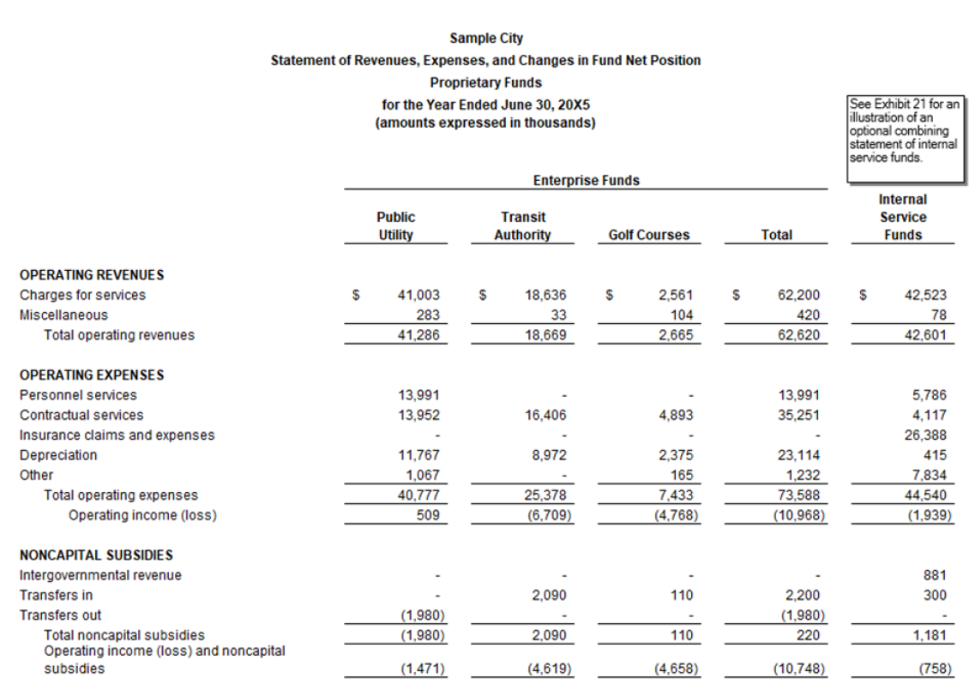
Example

Slide 29
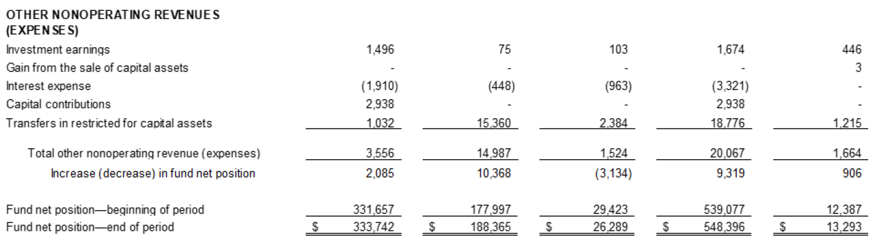
Example

Slide 30
Unusual or Infrequent Items – Definitions
Unusual or Infrequent Items
Unusual in nature – the underlying event or transaction should possess a high degree of abnormality and be of a type clearly unrelated to, or only incidentally related to, the ordinary and typical activities of the government, taking into account the environment in which the government operates. (GASB 62 par. 46a)
Infrequency of occurrence – the underlying event or transaction should be of a type that would not reasonably be expected to recur in the foreseeable future, taking into account the environment in which the government operates. (GASB 62 par. 46b)
Further details in GASB 62 (par. 47 & 48).

Slide 31
Unusual or Infrequent Items
Unusual or Infrequent Items
Separately present inflows and outflows of resources that are unusual in nature and/or infrequent in occurrence (replacing extraordinary and special items).
Disclose additional information about those inflows and outflows, including the programs, functions, or identifiable activities to which they are related and whether they are within the control of management.

Slide 32
Example Unusual/Infrequent
Cities:
  Flood, wildfire, tornado, or severe storm damage.
  FEMA or state disaster grants and related cleanup costs.
  One‑time settlement for a lawsuit unrelated to routine claims.
  Includes both payments and insurance recoveries.
  Sudden loss of a major facility due to fire or structural failure.
  Not part of planned capital management.
Counties:
  Permanent closure of a jail, hospital, or landfill due to safety or regulatory action.
  Large write‑off of remaining asset value.
  Repayment of prior‑year grant funding due to compliance findings.
  Not part of ongoing funding patterns.
  Large‑scale emergency response costs tied to a specific, nonrecurring event.

Slide 33
Example Unusual/Infrequent
State:
Example 1: Major disaster response at the statewide level
Wildfire suppression, hurricane recovery, or flood mitigation.
Large one‑time federal reimbursements.
Example 2: One‑time pension or benefit settlement
Settlement of litigation affecting retirement systems.
Not part of annual benefit funding.
Example 3: Emergency legislative actions
One‑time appropriations or reversals tied to extraordinary events.

Slide 34
Example Unusual/Infrequent
Special Districts:
Example 1: Sudden infrastructure failure
Dam breach, pipeline rupture, or treatment plant collapse.
Emergency repairs and related aid.
Example 2: Forced regulatory shutdown
Environmental authority orders immediate closure of operations.
Write‑offs and remediation costs.
Example 3: Abandonment of a major capital project
Cancellation of a project after substantial costs incurred.
No expectation of recurrence.

Slide 35
Example Unusual/Infrequent
School District:
Example 1: Natural disaster damage to schools
Flood, fire, or tornado destroys or severely damages facilities.
Related grants and cleanup costs.
Example 2: Abrupt enrollment‑driven closure
Emergency closure of a school mid‑year.
Large write‑offs of remaining assets.
Example 3: One‑time legal settlement
Settlement related to historical claims or governance issues.

Slide 36

Example Unusual/Infrequent
Items that usually do NOT qualify (across all entities):
  Budget overruns
  Revenue shortfalls
  Inflationary cost increases
  Routine litigation
  Grant expirations
These are expected risks of operations, not unusual or infrequent.

Slide 37
Additional Items
Major component unit information should be presented separately if it does not reduce readability. If so, combining statements of major component units should be included in the basic financial statements after the fund financial statements.
Budgetary comparison schedules should be presented as RSI for general and major special revenue funds that have legally adopted annual budgets:
  Within the RSI, separate columns should exist for:
    Variances between original and final budget amounts.
    Final budget amounts and actual results.
  Explanations of significant variations should be provided for both columns.
With regard to the statistical section, governments only engaged in business-type activities or only in business-type activities and fiduciary activities should present revenues by major source.

Slide 38
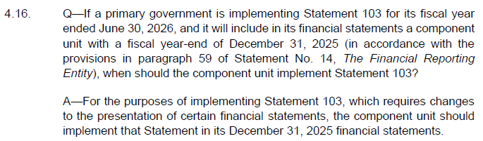
Primary Government and Component Units
Question from Implementation Guide No. 2025-1:

Slide 39

GASB 104, Disclosure of Certain Capital Assets
Notes:
History of the projectNonfinancial Assets pre-agenda research started 2020
Classification of Nonfinancial Assets project started 2022
Response to RTU assets created by Statements 87, 94, and 96
Should certain types of assets continue to be reported as capital assets?If not, what additional classifications are needed?
Result: more changes considered and rejected than actually madeAll assets considered still reported as capital assets
No overarching definition of nonfinancial assets

Slide 40

Effective Date
Fiscal years beginning after June 15, 2025.
Retroactive application if considered practicable:
  Apply to all periods presented in the basic financial statements.
  Note disclosure that Statement was implemented; describe financial statement line items affected.
  If not considered practicable to apply retroactively, disclose reason.

Slide 41
Classification of Nonfinancial Assets
Disclosure and classification of certain capital assets.
Certain capital assets would be required to be disclosed separately in the capital asset note disclosures required by Statement 34:
Asset Type | Disclose Separately (Asset and Amortization Balances)
Capital assets held for sale | By major class of asset (ending balances only)
Intangible capital assets | By major class(es) of asset
Lease assets (GASB 87) | By major class(es) of underlying asset
Right to use assets recognized by governmental (PPP) | By major class(es) of underlying asset operators (GASB 94)
Subscription assets (GASB 96) | Separate from other capital assets
Notes:
Intangible assets that represent the right to use a type of underlying asset should not be in same major class as owned assets of that type

Slide 42
Capital Assets Held for Sale
Capital assets to be classified as held for sale if:
The government has decided to pursue the sale of the asset.
It is probable that the sale will be finalized within one year of the financial statement date.
Factors to consider if it is probable that the sale will occur within one year:
Asset is available for immediate sale in its present condition.
Active program to locate buyer has been initiated, may include being put out for bid.
Market conditions for the type of asset.
Regulatory approvals needed to sell the asset.
No change to measurement.

Slide 43
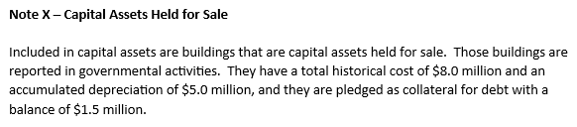
Disclosure Requirements
Capital assets held for sale should continue to be reported within the appropriate major class of capital assets and included in the capital asset footnote disclosure.
Right of use intangible assets (i.e. Leases, SBITAs & PPPs) should be included in the capital asset footnote disclosure.
Restatements/reclassifications required to the capital asset footnote are not likely.
Disclosure is required (within capital assets footnote area) – capital assets held for sale, associated costs, accumulated depreciation, and any related debt.

Slide 44
Example 1 – City: Surplus Police Station (Scenario + Rationale)
City vacates old police station after opening a new facility.
Council approves sale; property actively marketed; expected to close within 1 year.
Pre‑GASB 104 (what we often saw):
  Asset stayed in Buildings; disclosure was generic or absent.
  Users couldn’t tell it was being sold vs. just idle.
Post‑GASB 104 (what changes):
  Trigger met → disclose held‑for‑sale building: cost, accum. dep., and pledged debt (if any).
Notes:
This is a classic city fact pattern. The key pre‑GASB 104 issue wasn’t the accounting—it was visibility.
Before GASB 104, this building usually remained in Buildings and Improvements with limited narrative. Users could not easily see that the city was actively exiting the asset.
After GASB 104, once council approves the sale and closing within a year is probable, the city must disclose the held‑for‑sale building by major class, including historical cost and accumulated depreciation, and whether any debt is pledged as collateral.

Slide 45
Example 2 – County: Vacated Admin Building + Land (Scenario + Rationale)
County relocates offices; vacates annex building and adjacent land.
Board approves sale; broker/RFP initiated; expected to close within 1 year.
Pre‑GASB 104:
  “Surplus property” narrative; land and building remained in capital assets.
  No standardized disclosure of what was being sold.
Post‑GASB 104:
  Disclose held‑for‑sale assets by major class: Land vs. Buildings (include accum. dep. for buildings).
  Explicitly disclose pledged collateral debt, if any.
Notes:
Counties often used broad language like “surplus properties awaiting disposition.” Pre‑GASB 104, that approach created diversity and made it hard for users to identify what was actually being sold.
Post‑GASB 104, once the decision + probable‑within‑one‑year criteria are met, the county must provide a quantified disclosure by major class—land separately from buildings—and address pledged collateral debt.

Slide 46
Example 3 – State DOT: Excess Right‑of‑Way Parcels (Scenario + Rationale)
DOT identifies excess right‑of‑way parcels no longer needed for projects.
Disposal plan approved; sales process initiated; expected to close within 1 year.
Pre‑GASB 104:
  Excess parcels remained in Land with no held‑for‑sale identification.
  Users couldn’t distinguish operational ROW from parcels being sold.
Post‑GASB 104:
  Disclose land held for sale by major class (historical cost) and pledged debt (if any).
  Reassess each reporting period—remove if sale no longer probable within 1 year.
Notes:
DOT land is a great illustration of why GASB 104 matters.
Pre‑GASB 104, excess parcels often sat in Land for years with no clear disclosure that the DOT intended to sell them.
Post‑GASB 104, once the disposal plan is approved and closing within a year is probable, the DOT must identify the land as held for sale in the notes. Also, GASB 104 requires reassessment each year—if the sale stalls, it may no longer qualify.

Slide 47
Comparison Table – Held‑for‑Sale Examples (insert before note disclosures)
Ex. | Govt type | Asset / major class | Trigger | Disclosure required | Common audit focus
1 | City | Police station (Buildings) | Council approval + probable close ≤ 1 yr | Cost + accum. dep.; pledged debt (if any) | Evidence supports “probable within 1 yr”
2 | County | Admin site (Land & Buildings) | Board approval + active sale process | Disclose by major class; include accum. dep.; pledged debt | Completeness of assets captured
3 | State DOT | Excess ROW (Land) | Approved disposal plan + probable close ≤ 1 yr | Land cost; pledged debt; reassessment | Reassessment if sale delayed
Rationale: GASB 104 improves transparency – assets actively being sold are no longer buried in broad capital asset categories.
Notes:
This comparison table is the bridge between the examples and the note disclosure drafting.
Across all three scenarios, the accounting does not change. What changes is the requirement to explicitly identify held‑for‑sale assets once the criteria are met.
From an audit standpoint, the most common issues are (1) whether “probable within one year” is supported, (2) whether all approved sales were captured, and (3) whether the classification is reassessed if a sale is delayed.

Slide 48
Draft Note Disclosure – Example 1 (City: Police Station)
Pre‑GASB 104 (typical)
Post‑GASB 104 (draft)
Capital assets include buildings and improvements used in governmental operations. Certain facilities that are no longer in service are included in capital assets at historical cost less accumulated depreciation.
Capital Assets Held for Sale
  As of June 30, 20XX, the City had one building classified as a capital asset held for sale. During the fiscal year, the City approved the sale of a former police station that is no longer used in operations and has been actively marketed for sale. The City expects the sale to be completed within one year of the financial statement date.
  The historical cost of the building classified as held for sale was $X,XXX,XXX, with accumulated depreciation of $X,XXX,XXX as of June 30, 20XX. The building is not pledged as collateral for outstanding debt.
Notes:
The pre‑GASB 104 language is representative of what we often saw—generic and not very transparent.
The post‑GASB 104 draft adds the required elements: explicit identification as held for sale, the one‑year probability assertion, and the quantified disclosure by major class including historical cost and accumulated depreciation, plus pledged collateral debt disclosure.

Slide 49
Draft Note Disclosure – Example 2 (County: Admin Building + Land)
Pre‑GASB 104 (typical)
Post‑GASB 104 (draft)
Land and buildings include properties currently used in operations as well as certain surplus properties awaiting disposition.
Capital Assets Held for Sale
  The County classified certain land and a former administrative building as capital assets held for sale as of June 30, 20XX. The County has formally approved the sale of these assets and expects the transactions to be completed within one year of the financial statement date.
  Capital assets held for sale consist of land with a historical cost of $X,XXX,XXX and buildings with a historical cost of $X,XXX,XXX and accumulated depreciation of $X,XXX,XXX. No outstanding debt is secured by these assets.
Notes:
Use this slide to emphasize the major‑class separation.
Post‑GASB 104, land and buildings should not be blended. Buildings need accumulated depreciation. And even if there is no pledged collateral debt, it is good practice to state that explicitly.

Slide 50
Draft Note Disclosure – Example 3 (State DOT: Excess ROW Land)
Pre‑GASB 104 (typical)
Post‑GASB 104 (draft)
Land includes parcels acquired for transportation purposes, including right‑of‑way no longer required for active projects.
Capital Assets Held for Sale
  The Department classified certain excess right‑of‑way land as capital assets held for sale as of June 30, 20XX. Management has approved the sale of these parcels and expects the sales to be completed within one year.
  The historical cost of land classified as held for sale totaled $X,XXX,XXX as of year‑end. The land is not pledged as collateral for outstanding debt.
Notes:
This example is where reassessment is an easy talking point.
DOTs often have parcels listed for sale that can drag on. GASB 104 requires reassessment each reporting period, so if a sale is no longer probable within one year, the asset should come out of the held‑for‑sale disclosure.

Slide 51
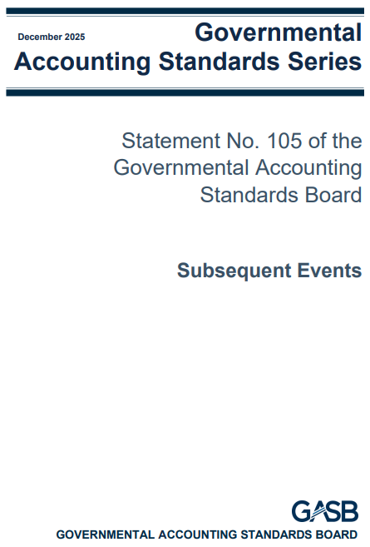
GASB 105, Subsequent Events

Slide 52

Subsequent Events
Effective date – fiscal years beginning after June 15, 2026.
Enhance clarity/consistency for subsequent events reporting.
Transactions/events occurring after the date of the financial statements and before the date the financial statements are available to be issued:
  Available to be issued:
    Complete and GAAP-compliant.
    Approvals for issuance have been obtained.
Disclose date through which subsequent events are evaluated.

Slide 53

Subsequent Events – Types
Recognized Events:
  Evidence of conditions existing at the financial statement date that inform accounting estimates reported as of the financial statement date.
  Example: Customer bankruptcy indicating pre-existing financial stress (occurring during the subsequent event time frame).

Slide 54
Subsequent Events – Types
Nonrecognized Events:
  Event that results in a significant effect (favorable or unfavorable) that is recognized or disclosed in the basic financial statements in the reporting period in which the event occurs and is one of the following:
    A debt-related transaction (does not include regularly scheduled debt service payments).
    A government combination or a disposal of government operations.
    A change to the legally separate entities that compose the financial reporting entity.
    A transaction or other event that is of such a nature that the information is essential to a user’s analysis for making decisions or assessing accountability.
  Nonrecognized events do not inform conditions that existed at the financial statement date, and therefore, the effects related to nonrecognized events should not be incorporated into amounts reported as of the financial statement date. Instead, the event should be disclosed in the notes to the financial statements.

Slide 55
Required Note Disclosures
Disclosure for all financial statements:
  Date through which the subsequent events have been evaluated. The date should be disclosed regardless of whether there is a recognized or nonrecognized event.
Note X – Subsequent Events
Management evaluated subsequent events through [Date], the date the financial statements were available to be issued.
Nonrecognized Events:
  The following should be disclosed for a nonrecognized event:
    A description of the nonrecognized event and its effect.
    An estimate of the amount of the effect of the nonrecognized event, or the reason why an estimate of the amount cannot be made.
  Disclosure should correspond to the reporting units in the financial statements. Information that is the same for more than one reporting unit should be combined to avoid duplication.

Slide 56
Required Note Disclosures
Nonrecognized Events – Disclosure Example
Nonrecognized Subsequent Events
[Describe events that occurred after the financial statement date but do not require adjustment, including nature and estimated financial effect, if known.]
Issuance of Bonds:
  On [August 10, 2027], the City issued $10 million in revenue bonds for water system improvements, Series 2027. The bond issuance occurred after the City’s fiscal year‑end of [June 30, 2027] and therefore does not provide evidence of conditions that existed at year‑end. The Series 2027 Bonds carry an interest rate of 4.10% with a final maturity of [December 1, 2047]. Annual debt service payments are scheduled to begin on [December 1, 2027], with total estimated debt service obligations of $32.4 million over the life of the bonds. These amounts represent the known financial effect of the bond issuance on future periods.

Slide 57
Required Note Disclosures
Nonrecognized Events – Disclosure Example
Natural Disaster:
  On [Date], a major [Type of Disaster] damaged several municipal facilities. The [type of disaster] occurred after the fiscal year‑end and does not provide evidence of conditions existing as of [June 30, 2027]; therefore, it is not recognized in these financial statements. The City’s estimated cost of repairs is $[Amount].
New Grant:
  On [January 20, 2027], the City received notification of approval for a five‑year federal grant totaling [$X,000,000] to establish the [Community Wellness Initiative]. The grant was awarded after the City’s fiscal year‑end of December 31, 2026, and therefore does not reflect conditions existing at year‑end. As a result, the grant is not recognized in the accompanying financial statements. The program will require the City to hire two new staff positions and to provide a 50% local match for eligible costs. Because program design, staffing, and matching requirements are still being evaluated, the financial impact cannot be reasonably estimated at this time.

Slide 58
Required Note Disclosures
Nonrecognized Events – Disclosure Example
Abrupt Discontinued Grant Funding:
  On [January 25, 2027], the City received notice from the U.S. Department of [Agency] that the [Program Name] federal funding program would be discontinued immediately. Because the notice was received after the City’s fiscal year‑end of [December 31, 2026], and the discontinuation does not provide evidence of conditions existing at year‑end, this event is not recognized in the accompanying financial statements.
  The city is evaluating operational impacts and will assess options for redirecting costs, identifying alternative funding sources, and adjusting program staffing and service levels. However, due to the abrupt nature of the announcement and pending federal clarification, the financial effect of the discontinued funding cannot be reasonably estimated at this time.
Discontinued Grant Funding in Future Budget Periods:
  On [July 27, 2027], the City received notice from the U.S. Department of [Agency] that the [Program Name] Grant will not be extended or renewed beyond the current budget period ending [September 30, 2027]. This notification was received after the City’s fiscal year‑end of [June 30, 2027] and therefore does not provide evidence about conditions existing at year‑end. Accordingly, the event is not recognized in the accompanying financial statements.
  The nonrenewal will require the city to evaluate future service levels, identify alternative funding sources, and assess potential impacts on staffing and program operations. Because planning efforts remain in early stages and federal guidance regarding close‑out procedures has not yet been issued, the financial impact of the grant’s non-extension cannot be reasonably
  estimated at this time.

Slide 59
Questions?

Slide 60
Janeen Hathcock
Partner
jhathcock@eidebailly.com
303.586.8548

