Slide 1
CGFOA Immersion Series Session 3
September 23, 2025

Slide 2


^{DISCLAIMER}
This presentation is presented with the understanding that the information contained does not constitute legal, accounting or other professional advice. It is not intended to be responsive to
any individual situation or concerns, as the contents of this presentation are intended for general information purposes only. Viewers are urged not to act upon the information contained in this presentation without first consulting competent legal, accounting or other professional advice regarding implications of a particular factual situation. Questions and additional information
can be submitted to your Eide Bailly representative, or to the presenter of this session.

Slide 3




Presenters
Paul Kane, CPA
Assurance Partner
Denver, Colorado
Jill Morasko, CPA
Assurance Manager
Missoula, Montana
Russ Olson
SD Auditor General

Slide 4
Today’s agenda
Critical GASB Pronouncements for Governmental Entities
Interim and Year-end Budget Monitoring and Reporting

Slide 5
Today’s agenda for Critical gasb pronouncements
Understand the purpose and application of GASB Statement No. 75 (OPEB).
Understand the purpose and application of GASB Statements No. 87 & 96 (leases & SBITAs).
Learn about current and upcoming GASB Statements, including Nos. 101 and 103.
Understand the purpose and application of GASB Statement No. 68 (pensions).

Slide 6


Slide 7
Overview of GASB Requirements for Pensions
GASB 67 provides for accounting with respect to Plans (replaces GASB 25).
GASB 68 provides for financial reporting by employers (replaces GASB 27):
  “Employers” are the entities making the contributions (e.g., State, Cities, Counties, School Districts, etc.).
Net Pension Liability reported on each employer’s “balance sheet” and in each Plan’s notes to the financial statements:
  Entry age cost method now required.
  Market value of assets are part of the equation.
  Blended discount rate now required based on cash flows.
Accounting and financial reporting divorced from contribution requirements.
Annual pension expense (for employers) is essentially equal to Change in Net Pension Liability during the year, with deferrals of certain items.

Slide 8
GASB Objectives and Goals
Focus on FINANCIAL REPORTING not operations:
  GASB establishes accounting and financial reporting standards, not funding policies.
  Focus on pension obligation, changes in obligation, and attribution of expense.
  Therefore – converting from modified cash to accrual basis.
Assume Governments Last Longer than 1 year Unlike Businesses:
  Cost of services to long-term operation.
  “Interperiod equity” matches current period resources and costs.
Use Federal Guidance (US DOL / SSA) on Who is an Employee and Who they Work For:
  Employer incurs an obligation to its employees for pension benefits.
  Transaction is in context of a career-long relationship.
  Therefore – EMPLOYER has reporting and not plan.

Slide 9
The GASB Revolution
FOUR Major Focus Areas in the new standards:
  Placing the Net Pension Liability on the Balance Sheet.
  Decoupling Expense from Funding.
  Accounting for Cost-Sharing Plans.
  Expanding Disclosure Information (Notes & RSI).
Timing of Measurements, Effective Dates.
Implementation Guides and Audit Guidelines.

Slide 10
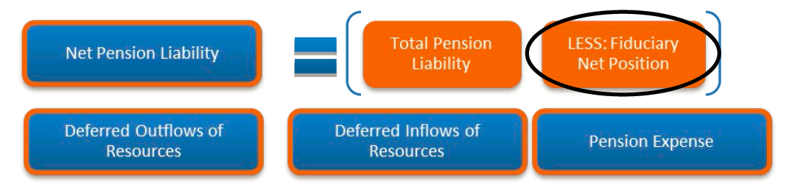
Net Pension Liability is Simple…
Fiduciary Net Position is the market value of assets less investment related liabilities and payables – effectively the “account” held at the Plan.
Deferred outflows of resources, deferred inflows of resources and pension expense are solely employer related, but calculated by the Plan.

Slide 11
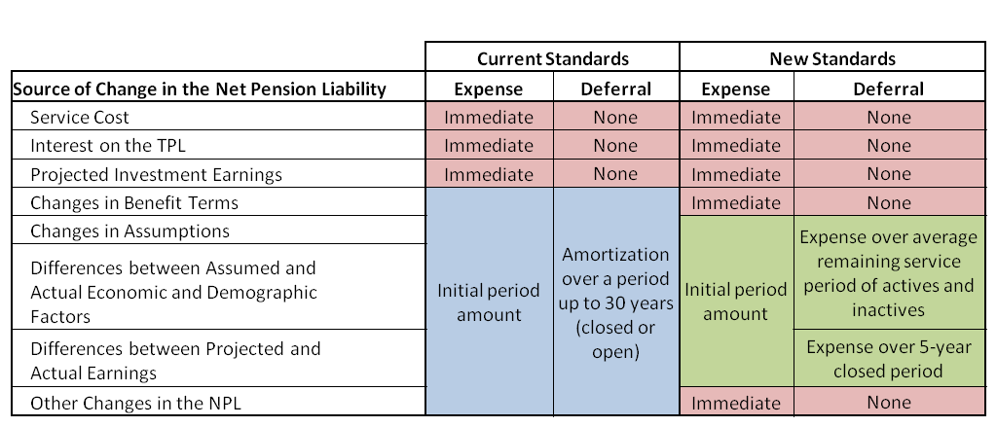
Summary of New Pensions Expense Components – a great cheat sheet
Changes in the employer’s Net Pension Liability will be recognized in pension expense more quickly – could be confusing.

Slide 12
What Type of Plan
Single employer:
  Primary governments and component units are considered to be one employer:
    What if other de minimis employers participate in the plan?
    What if a component unit has a different fiscal year end?
Agent multiple employer:
  Assets are pooled for investment purposes.
  Separate accounts are maintained for each individual employer so that each employer’s share of the pooled assets is LEGALLY available to pay the benefits of ONLY its employees:
    Separate actuarial valuations for different employers or specific groups of employees for
    different employers does not always equate to an agent plan.

Slide 13
Cost-Sharing Multiple Employer
Cost-sharing multiple employer:
  Pension obligations to the employees of more than one employer are pooled and pension plan assets can be used to pay the benefits of the employees of any employer that provides pensions through the pension plan:
    Somewhat of a default category.
    Elements of cost-sharing multiple employer provisions used for internal allocations to government to enterprise funds and potentially component units.

Slide 14
Number of Pension Plans
A separate defined benefit pension plan should be reported for a portion of the total assets, even if the assets are pooled with other assets for investment purposes, if that portion of assets meets both of the following criteria:
  The portion of assets is accumulated SOLELY for the payment of benefits to certain classes or groups of plan members or to plan members who are the active or inactive employees of certain entities.
  The portion of assets may not LEGALLY be used to pay benefits to other classes or groups of plan members or other entities’ plan members.
Can be used in the determination of agent versus cost-sharing
plan.

Slide 15
Timing of Measurement
Assume June 30, 2025 fiscal year end:
  Valuation no earlier than December 30, 2022 :
    No more than 30 months and 1 day before the employer’s fiscal year-end.
  Measurement no earlier than June 30, 2024:
    No earlier than 12 months prior to the reporting date.

Slide 16
Discounting
Long-term expected rate of return:
  To the extent that the plan’s net position is projected to be sufficient to make projected benefit payments (crossover).
  Crossover points could be different for agent employers.
Plan assets are expected to be invested using a strategy to achieve that return (often lost in the conversation).
Projected cash flows for contributions (trust, but verify):
  Statue, contract, or formal written policy – consider five-year history.
  Others – use five-year history:
    BE CAREFUL – FIVE YEAR HISTORY IS NOT IN STANDARD BUT IN PRACTICE.

Slide 17

Discounting
Yield or index rate for 20-year, tax-exempt general obligation municipal bonds with an average rating of AA/Aa or higher:
  No endorsement of any index by GASB beyond the minimum.
Overall approach still is controversial.
Also- could have multiple yields in one plan:
  Example, public safety has a different tier with different benefits, would have a different ‘run out’ date.

Slide 18

Accounting for
Cost-Sharing
GASB-68 – Recognize proportionate share of the plan’s total:
  Net Pension Liability.
  Pension Expense.
  Deferred Positions.
    NONE of these are to be reported on the plan financial statements due to employer : employee exchange of work for compensation.
Notes:
18

Slide 19
Example Schedule of Cost Sharing Proportion
Based on prior covered payroll – but beware (see later)

Slide 20
Example Schedule of Employer Pension Amounts Allocated by Cost Sharing Plan

Slide 21
GASB 68 Footnote Disclosures (All Employers)
Plan Description and Related Information (census not necessary for cost sharing employers)
Changes in Net Pension Liability (NPL)
Significant Assumptions
Discount Rate and Key Discount Rate Assumptions
Pension Plan’s Fiduciary Net Position
Measurement and Actuarial Valuation Date
Changes/New Assumptions made related to Benefit Terms
Changes made subsequent to Measurement Date
Current Period Pension Expense
Schedule of Deferred Outflows/Inflows of Resources

Slide 22
Required Supplementary Information
2 Schedules out to 10 years:
  Schedule of Changes in Net Pension Liability and Related Ratios:
    Elements of total pension liability.
    Elements of Plan fiduciary net position.
    Net is change in plan fiduciary net position:
      Change is added to/ subtracted from beginning net position.
    Net of total pension liability and plan fiduciary net position is net pension liability:
      Ratio is done (similar to old funded ratio).
      NPL compared to covered payroll.
  Schedule of Contributions:
    Actuarially determined contribution.
    Contributions made.
    Deficiency (excess).
    Covered payroll.
    Contributions as a % of covered payroll.

Slide 23
A Real Example
Measurement Date: June 30, 2024
Reporting Date: June 30, 2025
Beginning Net Pension Liability (NPL): $4,800,000
Ending Net Pension Liability (NPL): $5,300,000
Deferred Outflows (Change from PY):
  Differences Between Expected and Actual Experience: +$90,000
  Changes in Assumptions: -$160,000
Deferred Inflows (Change from PY):
  Change in Proportion: -$80,000
  Differences Between Projected and Actual Earnings: +$70,000
Pension Expense: $500,000
Employer Contributions Made During FY24: $300,000
Employer Contributions Made During FY25: $360,000

Slide 24
A Real Example – Journal Entries
 | Debit | Credit
Deferred Outflows of Resources – Experience | $90,000
Deferred Outflows of Resources – Assumptions |  | 160,000
Deferred Inflows of Resources – Chg in Prop | 80,000
Deferred Inflows of Resources – Earnings |  | 70,000
Net Pension Liability |  | 500,000
Pension Expense | 560,000

Slide 25
A Real Example – Journal Entries
 | Debit | Credit
Pension Expense | $300,000
Deferred Outflows of Resources – Contributions |  | 300,000
Deferred Outflows of Resources – Contributions | 360,000
Pension Expense |  | 360,000

Slide 26


OPEB – Employers
Statement 74
Financial Reporting for Postemployment Benefit Plans Other Than Pension Plans
Statement 75
Accounting and Financial Reporting for Postemployment Benefits Other Than Pensions

Slide 27

OPEB Reporting –
Key Provisions – Reminder
Mirrors pension standards.
Measurement may increase size of long-term obligation and annual cost for OPEB.
Recognize the net liability on the face of the financial statements.
Present more extensive note disclosures and supporting schedules.
Due to beginning balance restatement –
similar effort to GASB-68 in implementation if it applies!!!
Effective Date – Fiscal Years Beginning after | Statement | June 30th Governments | December 31st Governments
June 15, 2016 | GASB-74, OPEB Plans | 2017 | 2017
June 15, 2017 | GASB-75, OPEB Employers | 2018 | 2018

Slide 28
Walking before we run – what is OPEB?
OPEB (OTHER POSTEMPLOYMENT BENEFITS) Includes:
Can be either defined benefit (DB) or defined contribution (DC) plan:
  OPEB DC Plans:
    Individual accounts for each employee.
    Defined contributions (either from employer or from nonemployer) during employee’s active service.
    Payments to employee dependent on contributions, earnings, effect of forfeitures / credits and administrative expense.
  All others likely DB.
ALWAYS | Healthcare – medical, dental, vision, hearing
MAYBE | Death benefits, life insurance, disability, long-term care if separate from a pension plan
NEVER | Termination benefits, termination payments for sick leave, (but may be a funding source for OPEB,) elements previously provided in a pension plan

Slide 29
FYI – Types of OPEB Plans
Type of Plan a Member of | Example
Single Employer Plan | Municipal Healthcare Plan (and component units within reporting entity)
Agent Multiple-Employer Plan – [Plan assets are pooled for investment purposes but separate accounts are maintained for each individual employer so that each employer’s share of the pooled assets is legally available to pay the benefits of only its employees]. | Statewide Agent Multiple-Employer Plan, but with separate accounts for each employer
Cost-Sharing Multiple-Employer Plan – [Plan includes more than one employer – assets and benefits are pooled] | Countywide Employees Healthcare Plan (for the County and it’s separate municipalities)

Slide 30
FYI – GASB’s Authoritative LiteraturE
GASB Statements
GASB Codification sections
GASB-74 (OPEB Plans)
GASB-75 (OPEB Employers)
GASB-85 (Omnibus)
Implementation Guide 2017-1 (Plans)
Implementation Guide 2017-3 (Employers)
Implementation Guide 2018-1
(Additional Questions and Answers)
Po50 – DB OPEB Plans
Po51 – DC OPEB Plans
P50 – Employer Reporting DB / Trust
P51 – Employer Reporting DC / Trust
P52 – Employer Reporting DB / No Trust
P53 – Employer Reporting DB / If assets accumulated, but No Trust
P54 – Employer Reporting DC / No Trust

Slide 31
Big Deals for OPEB Employers
GASB-75 replaces all provisions of GASB-45 (and 57) as applicable:
  Discount rate will no longer be blended like GASB-45 – for most employers that are not funded, AA bond index rate like GASB-68 (may be a benefit by the way…).
  OPEB expense will likely be more volatile due to funding levels.
  Slightly different terminology (Normal Cost = Service Cost).
  Nearly all other aspects similar to GASB-68 as amended.
  Note disclosure and RSI all replaced upon implementation.
  Beginning balance restatement required like GASB-68.

Slide 32
Additional Big Deals for OPEB Employers
Revision of recognition, measurement, disclosure for all employers (GASB-45, 57):
  Net OPEB Liability (NOL) =
    OPEB Fiduciary Net Position (allocated or direct) less;
    Total OPEB liability.
  Recognized in full accrual financial statements.
  Changes in liability:
    Expense in period.
    Other elements include deferred outflows / inflows of resources with expense recognized over defined future periods.

Slide 33
Additional Big Deals for OPEB Employers
Liability may be heavily influenced by:
Medicare ‘toggle’ (conversion to Medicare upon being eligible).
Insured plans (where insurer assumes risk of healthcare liability and employer only risk is for premiums).
Changes in Legislation (both State and Federal).

Slide 34
OPEB
Liability measured either:
  Employer fiscal year end.
  Measurement date of NOL:
    As of a date no earlier than end of prior fiscal year;
    Liability / plan net position as of the same date.
Actuarial valuation date of total OPEB liability (TOL):
  If not measurement date – same provisions as pensions apply (30 months + 1 day) prior to FYE.
  Must be at least biennially with more frequent encouraged.

Slide 35
OPEB
Measurement process same as Total Pension Liability, Except Including Healthcare Cost Trend:
Project benefit payments.
Discount payments to actuarial present value.
Attribute the PV to periods.
Assumptions:
Follow actuarial standards of practice.
General assumptions like pensions for GAAP.
No change needed for funding purposes.
Trust vs. No Trust:
Trust – report NOL (if assets available).
No Trust – report TOL.

Slide 36
OPEB
Non-trust provisions – most common:
  Again - Likely no assets, so Total OPEB Liability reported.
  Agent employers similar (all liability reported on employers books).
Other stuff similar to pensions:
  RSI.
  Transition provisions / restatement of beginning balances.
  Exception for employer contributions subsequent to measurement date always deferred outflows of resources.

Slide 37
What goes into the annual financial report?
Government-wide / accrual basis Statements
Governmental funds
Net OPEB liability (if Trust) (Otherwise TOL).
Deferred inflows / outflows of resources.
OPEB expense allocated to programs / functions.
Payable to OPEB plan for contributions normally due and payable but not made prior to FYE.
OPEB Expenditures (amounts normally due and payable).
Nonemployer contributions.

Slide 38
EMPLOYER NOTE DISCLOSURES DIFFER BY PLAN TYPE
Description | 1 | 2 | 3 | 4
Name of plan, administrator, type of plan | Y | Y | Y | Y
Benefit terms (classes of employees covered, types of benefits, key elements, terms of policies for benefit changes, COLAs, legal authority | Y | Y | Y | Y
Number of employees covered | Y |  | Y
Fact that no assets held in trust |  |  | Y | Y
Contribution requirements (authority, legal or maximum rates, contributions made) | Y | Y
Authority to pay OPEB benefits due and amount |  |  | Y | Y
Availability of audited financial statements | Y | Y
Type
1 – Trust – Single / Agent
2 – Trust – Cost sharing
3 – Non-Trust – Single
4 – Non-Trust – Primary Government and Component Unit Stand-Alone reporting

Slide 39
EMPLOYER NOTE DISCLOSURES DIFFER BY PLAN TYPE
Assumptions and Other Inputs | 1 | 2 | 3 | 4
Inflation, healthcare cost trend rates, salary changes, benefit changes | Y | Y | Y | Y
Mortality source | Y | Y | Y | Y
Experience studies | Y | Y | Y | Y
Projections of sharing benefit costs follow established practices | Y | Y | Y | Y
NOL sensitivity – healthcare cost trend rate (± 1%) and discount rate | Y | Y
TOL sensitivity – healthcare cost trend rate (± 1%) and muni bond rate |  |  | Y | Y
Discount rate used, muni bond rate | Y | Y | Y | Y
Projected cash flow assumptions, long term expected rate of return, benefit payments applied to rates, asset allocation | Y | Y
Type
1 – Trust – Single / Agent
2 – Trust – Cost sharing
3 – Non-Trust – Single
4 – Non-Trust – Primary Government and Component Unit Stand-Alone reporting

Slide 40
EMPLOYER NOTE DISCLOSURES DIFFER BY PLAN TYPE
Additional Elements | 1 | 2 | 3 | 4
Plan’s fiduciary net position if not publicly available | Y | Y
Schedule of changes in NOL | Y
Schedule of changes in TOL |  |  | Y
Measurement date / AV date | Y | Y | Y | Y
Employer’s proportionate share of NOL and basis for allocation |  | Y |  | Y
Changes in benefit terms, changes after MD (subsequent event), OPEB expense for current period, deferred inflows / outflows amortization (5 years) | Y | Y | Y | Y
Type
1 – Trust – Single / Agent
2 – Trust – Cost sharing
3 – Non-Trust – Single
4 – Non-Trust – Primary Government and Component Unit Stand-Alone reporting

Slide 41
RSI Schedules
RSI elements | 1 | 2 | 3 | 4
Changes in NOL by source | Y
Changes in NOL and related ratios | Y
Proportionate share of NOL |  | Y
Employer contributions | Y | Y
Changes in TOL by source |  |  | Y
TOL as a percent of covered employee payroll* |  |  | Y
Proportionate share of TOL |  |  |  | Y
Notes to RSI | Y | Y | Y | Y
Type
1 – Trust – Single / Agent
2 – Trust – Cost sharing
3 – Non-Trust – Single
4 – Non-Trust – Primary Government and Component Unit Stand-Alone reporting
*If contributions to the OPEB plan are based on pay, covered payroll is used

Slide 42
Defined contribution OPEB – easy peasy
OPEB Expense =
Amounts attributable to reporting period.
Net of forfeited amounts removed from employee accounts.
OPEB Liability =
Difference between OPEB expense and contributions.
Note Disclosures:
Plan information.
Benefit terms.
Contribution rates.
Expense.
Amount of forfeitures.
Amount of liability.

Slide 43
Employer’s Implementation Guide
507 Questions and Answers (You read that right…):
  But – only 19 ‘new’ questions – rest are from existing Guides.
4 New Questions and Answers that May Change GASB-74 reporting in limited circumstances.
Categories of Illustrations:
  Determination of Benefit Payments If Blended Premium Rates Are Stated.
  Determination of the Discount Rate in Circumstances in Which Benefits Are Paid by the Employer with Its Own Resources as They Come Due and the OPEB Plan Is Administered through a Trust.
  Determination of Certain Amounts to Be Presented in a Single or Agent Employer’s RSI Schedule of Contribution-Related Information.
  Note Disclosures, RSI and Calculation of Certain Recognized Amounts for a Cost-Sharing Employer.

Slide 44
GASB-87, Leases

Slide 45
What is a Lease under GASB 87?
Definition:
  A lease is defined as a contract that conveys control of the right to use another entity’s nonfinancial asset (e.g., land, buildings, vehicles, equipment) for a period of time in an exchange or exchange-like transaction.
Key Elements:
  Control: The right to obtain present service capacity and determine the nature and manner of use.
  Nonfinancial Asset: Tangible assets not held primarily for income or resale.
  Exchange Transaction: Both parties receive and give up essentially equal value.
Exclusions:
  Intangible assets (e.g., software licenses).
  Biological assets (e.g., timber, living plants).
  Inventory and service concession arrangements.

Slide 46
Lessee Accounting under GASB 87
Recognition:
  Lease Liability: Present value of future lease payments.
  Right-to-Use Asset: Equal to the lease liability, adjusted for prepayments or incentives.
Measurement:
  Includes fixed payments, variable payments based on index/rate, and reasonably certain options to extend or terminate.
Amortization & Interest:
  Right-to-use asset is amortized over the lease term.
  Lease liability is reduced as payments are made, with interest expense recognized.
Disclosures:
  Description of leasing arrangements.
  Schedule of future lease payments.
  Lease term and discount rate assumptions.

Slide 47
Lessor Accounting under GASB 87
Recognition:
  Lease Receivable: Present value of future lease payments.
  Deferred Inflow of Resources: Equal to the lease receivable plus any payments received at or before commencement.
Revenue Recognition:
  Recognize lease revenue over the lease term in a systematic and rational manner.
Measurement:
  Similar to lessee: includes fixed and certain variable payments.
Disclosures:
  Description of leasing arrangements.
  Schedule of future lease receipts.
  Information about contingent lease payments.

Slide 48
GASB-96, Subscription-based Information Technology arrangements

Slide 49

What Is a SBITA?
Paragraph 6
“…a SBITA is defined as a contract that conveys control of the right to use another party’s IT software*, alone or in combination with tangible capital assets…as specified in the contract for a period of time in an exchange or exchange-like transaction.”
*Common examples include SaaS products, IaaS (Infrastructure as a Service), and PaaS (Platform as a Service).
Yes – the definition of a SBITA nearly mirrors the definition of a lease under GASB 87.

Slide 50

WHAT IS A SBITA?
Period Of Time Has Been Key.
Some contracts have no time (other than monthly or annual renewals until canceled).
If contract has a cancellation provision:
  It may be a short-term contract. Don’t just throw it away, inventory it to include with disclosures.
  Will not be a perpetual license (purchase of SBITA also unlikely)!

Slide 51

WHAT ABOUT ‘CLOUD-BASED’ STORAGE?
Pervasive Issue: cloud-based systems may or may not be SBITAs!
Models provide a right-to-use combination of IT Hardware and Software.
Key Question – Is There Control of the storage space?
  If Yes – SBITA
  If No – Not a SBITA

Slide 52
GASB 96 and GASB 87 Are Different!
GASB 96 solely provides guidance for Users of IT software.
GASB 96 does Not apply when the IT software component is insignificant compared to the costs of the tangible capital asset.
SBITAs effectively meet the definition of a lease per GASB 87.
Whether a SBITA is in scope for GASB 96 depends on the underlying assets involved:
IT software only – GASB 96.
Tangible IT asset only – GASB 87.
Combination of IT software and tangible IT asset:
  If the software component is insignificant compared to the tangible IT asset – GASB 87.
  If not – GASB 96.

Slide 53
An Example Will Help You Understand
Subscription Liability
Initially measured at the “present value of payments expected to be made during the subscription term.”
Subscription Asset
Initially measured at the lease liability value + capitalizable initial implementation costs.
Example Details
Three-year contract starting 7/1.
Contract termed as a ‘lease’ (common for SBITAs – be careful!).
Annual payments of $5,000.
Discount rate of 2%.
Incurred implementation costs of $2,000.

Slide 54
An Example Will Help You Understand
Subscription Liability
  Calculated to be $14,708 using software.
Subscription Asset
  Initially measured at the lease liability value:
  + capitalizable initial implementation costs…hmmm…
Example Details
Three-year contract starting 7/1.
Contract termed as a ‘lease’ (common for SBITAs – be careful!).
Annual payments of $5,000.
Discount rate of 2%.
Incurred implementation costs of $2,000.

Slide 55
An Example Will Help You Understand
Subscription Liability
  Calculated to be $14,708 using software.
Subscription Asset
  Calculated as follows:
    $14,708 for initial liability +
    $2,000 of implementation costs =
    $16,708 initial subscription asset value
Example Details
Three-year contract starting 7/1.
Contract termed as a ‘lease’ (common for SBITAs – be careful!).
Annual payments of $5,000.
Discount rate of 2%.
Incurred implementation costs of $2,000.

Slide 56

How Did We Calculate the Liability? It May Include…
Fixed payments.
Variable payments that depend on an index or rate (such as CPI measured at the beginning of the term).
Variable payments with minimums or maximums.
Penalties for terminations if exercised due to options, fiscal funding or cancellations.
SBITA contract receivables from the vendor (offsets liability).
Any other payments to the vendor if reasonably certain.

Slide 57

What If You Have Outlays Other than Subscription Payments?
PARAGRAPH 29
  Activities associated with a SBITA – other than a government making subscription payments to the SBITA vendor for the right to use the underlying IT assets – should be grouped into the following stages:
    Preliminary Project Stage (expensed as incurred).
    Initial Implementation Stage (capitalized).
    Operational & Additional Implementation
    Stage (generally expensed as incurred).

Slide 58
What About Large Projects that Are SBITAs?
Enterprise Resource Planning (ERP) systems tend to be:
  Multiyear implementations
  Complex
  Costly
Reminder – Multiple phases of implementation drive accounting decisions:
  New modules must add new functionality to be capitalized.
Preliminary Project Stage - Expense
Application Development - Capitalize
Subscription, Operations, Expense
Training Is Expensed!

Slide 59
Cheat Sheet for SBITA Stages
Preliminary Project Stage (EXPENSE) | Initial Implementation Stage (CAPITALIZE) | Operational and Additional Implementation Stage (EXPENSE)
Requests for Proposals Costs | Configuration | Stabilization
Demonstration Costs | Coding | Training
Project Management Office (PMO) Costs BEFORE selection of final alternatives | Testing, Parallel Processing prior to Go Live and installation | Conversion of unneeded data / archived / legacy data
Legal to review RFP | Initial conversion to get the system to “Go Live” | Outlays after go live that do not increase functionality / efficiency
Prior System Costs | PMO Costs after Go Ahead
PERIOD TO GO AHEAD | PERIOD TO GO LIVE | AFTER GO LIVE

Slide 60
Bottom Line on GASB-87 vs. 96
Terminology – specific terms to each.
GASB-87 should be implemented by most governments by now, GASB-96 just starting.
GASB-87 involves tangible capital assets, results in lease liability and a right-to-use asset for lessees.
GASB-87 has lessor provisions.
GASB-96 involves only the end-user, no GASB GAAP for vendors.
GASB-96 involves a subscription for software, hardware or a combination.
GASB-96 results in a right-to-use asset and a SBITA liability (unless paid in advance).
SBITAs have capitalizable implementation costs – but not all costs.
Footnotes are similar, but should be presented separately.
Accounting is like lessees.

Slide 61
Bottom Line on GASB-87 vs. 96
SBITAs may have very different asset and liabilities due to prevalence of payments prior to SBITA term.
SBITAs may be implemented in ‘waves’ resulting in additional assets.
SBITA assets may be amortized over a short period due to technology obsolescence.
Lease liability and asset for lessees at inception could be equal unless prepaid amounts or incentives.

Slide 62
Debits and Credits on One Sheet – SBITAs
 | Party | Assets | Liabilities | Deferred Inflow of Resources
Initial Reporting | Subscriber | Intangible subscription asset (SBITA liability + prepayments + capitalizable initial implementation costs) | Present value of future subscription payments (fixed, variable, including guarantees etc.) | None
 | Vendor | Beyond the scope of GASB-96 | N/A | N/A
Subsequent Reporting | Subscriber | Amortize intangible over shorter of useful life of SBITA or term | Reduce by subscription payments ONLY (effective interest) | None
 | Vendor | Beyond the scope of GASB-96 | N/A | N/A

Slide 63
GASB 101 – compensated absences
Effective: Fiscal Years Beginning after December 15, 2023 (12/31/24, 6/30/25, 9/30/25)
Level of Effort: medium

Slide 64
GASB Statement No. 101, Compensated Absences
One of the oldest still in use GASB standards (nearly 30 years) (GASB-16).
Inconsistent GAAP due to two allowable methods to calculate liability.
No guidance for types of PTO such as unlimited, sabbaticals, floating days, leave banks.
We all know that the note disclosure is fudged! (beginning balance is decreases, ending balance is increases).

Slide 65
What are the key differences from statement 16?
THERE IS NO DISTINCTION BETWEEN VACATION AND SICK LEAVE
THERE ARE NO OPTIONS FOR ACCRUING A SICK LEAVE LIABILITY
LIKELIHOOD FOR ACCRUAL HAS BEEN LOWERED FROM PROBABLE TO MORE LIKELY THAN NOT (> 50%)
NO MORE “VESTING” ACCOUNTING FOR SICK LEAVE

Slide 66

WHAT DO I CONSIDER A COMPENSATED ABSENCE?
Leave for which employees receive:
  Cash when the employee uses the leave
  Cash upon termination
  Non-cash settlements
Examples include:
  Vacation and sick leave
  Paid time off
  Holidays
  Types of sabbatical leave

Slide 67



How Will Liability Be Recognized? 3 Criteria for unused leave
  Leave balance carried forward from prior period to current period or CY to next FY.
  Settled in future period.
  Liability related to services rendered by employee (earned).
  Measure at period end
  Caution – NOT FUTURE SERVICES!
  Leave is more likely than not (MLTN) to be paid (>50%), used, or settled (old GAAP is probable!).
  Recognize liability until paid (unless converted to pension or OPEB).
Accumulate
Attribute
Settlement
Notes:
more likely than not (MLTN)

Slide 68
1
Recognition of a liability (prior slide)
Leave that is attributable to services rendered, AND
Leave accumulates, AND
More likely than not to be used, paid, or settled
2
Are there exceptions? Of course there are!
Don’t recognize a liability until leave commences for (1) sporadic events (2) unlimited leave (3) holiday leave not at employee’s discretion.
3
WHAT ELSE DO I NEED TO KNOW ABOUT RECOGNITION?
Leave that has been used, and
Leave that has not yet been paid or settled
Include applicable salary related payments

Slide 69
MEASURING the liability for compensated absences
Leave that is MLTN to be paid at a different rate from the employee’s payrate then use the different rate.
If not attributable to a specific employee (shared pool) measure using an estimated pay rate representative of the eligible employees.
If MLTN to be settled by noncash means (other than to DB or OPEB) should be based on the amount is MLTN to be settled.
Use the employee’s payrate as of the date of the financials.
Gather Accumulated Leave meeting recognition criteria (unless MLTN settled thru other means)
Multiply leave hours X current pay rate as of F/S date, unless MTLN paid at different rate at time payment made
Comp Absences Liability
Add Salary related payments directly / incrementally related
1
2
3

Slide 70

MAJOR EXCEPTION – LEAVE THAT IS SPORADIC
Impacts small population, cannot be calculated with regularity.
Includes:
  Parental leave
  Jury Duty
  Military leave
  Unlimited leave
  Unscheduled shutdowns (natural disasters etc.)
Recognize when event has occurred.

Slide 71
Other Elements of GASB-101
Leave sharing pools – use estimated pay rate of employees that participate.
Leave paid by noncash means other than pension / OPEB conversions – use amount more likely than not to be settled.

Slide 72

What are the disclosure requirements?
LONG-TERM LIABILITY FOOTNOTE:
  Beginning and ending balances of compensated absences at year-end.
  Changes in the liability as either (1) separate increases and decreases or (2) the net increase or decrease as long as it is disclosed as “net”.
  The portion of the ending balance due within one year.
Disclosure of which funds will be used to liquidate the compensated absence is NO LONGER required.

Slide 73
FAQs
What about
“use it or lose it?”
Since no accumulation, no recognition until MLTN to be used.
What about indefinite carryforward of leave (aka Golden Handcuffs)?
Must be accrued as paid at termination – use existing policy at reporting date to calculate liability.
What about
unlimited PTO?
Recognize at current rate when used.
Which Pay Rate
Should I use?
Use the pay rate in effect AS OF GOVERNMENT’S YEAR END (not W-2 Year)!

Slide 74
FAQs
What about partial use / lose (does not carryover and is not paid at termination)?
Since no accumulation, no recognition as liability as it is forfeited at end of year.
What if partial use / lose but on a calendar year basis?
If fiscal year does not = calendar year, then accumulate liability. Estimate MLTN to be used before forfeit as liability.
What about comp time due to overtime paid on termination?
Attributable to services rendered. All leave MLTN to be paid. Calculate liability.
FMLA / Parental leave?
Only recognize when leave starts for entire leave due.
What about vacation leave granted first day of year in advance and earned throughout year?
At beginning of year, leave not attributable to services rendered, no liability. Comp absences liability should be evaluated at entity’s year end.

Slide 75
Cheat Sheet for You
When to Recognize Unused Leave Liability and Salary Related Payments for Compensated Absences? | … For Which Types of Leave?
When the leave is EARNED (Accumulates for services already rendered). | If more likely than not to be paid unless settled to a pension / OPEB plan.
Do NOT recognize | Leave settled to a pension / OPEB plan.
When leave starts | Military leave, jury duty, FMLA but not sick or unrestricted sabbatical leave.
When leave is taken | Unlimited leave and holidays (even if holidays float).

Slide 76

Keys to Success in Implementing GASB-101
Gather existing policies and procedures relating to compensated absences.
Align policies and procedures to current contracts, laws, regulations, ordinances.
Fill data gaps to make key decisions:
  More likely than not policy determination.
  Rate of pay for sick leave pools.
For large employee bases, consider (not required) for year of implementation:
  Actuary;
  Data analytics contractor; or
  Both.
Document exceptions.
Recognize liability.
Draft note disclosure.

Slide 77
Compensated Absences Are A Budget Issue Too!
Compensated absences that will ultimately be paid out as cash rather than taken as leave can have a significant budgetary impact on local governments when not properly planned for:
  Common practice to use salary savings from vacancies to offset some or all cash payments.
  Not always a realistic strategy with long-term employees that have large balances.
  Can create a mid-year need for supplemental appropriations and/or create budget challenges.
  Ultimately reduces budgetary flexibility.
Consider setting aside resources on an ongoing, regular basis to offset an appropriate portion of your compensated absences liability:
  Methodology will likely be unique to your agency’s circumstances.
  Consider building this methodology into your governing body-approved policy library.
  If this is something new to your budget process, educate executive leadership and elected officials on the importance of setting aside resources.
  Addressing this issue will mitigate unanticipated budget impacts from retirements and
  separations.

Slide 78
Summary of GASB-101 You Can Use
GASB-101 changes liability recognition that has been in place for over 30 years.
Requires liability for:
  Leave that has not been used; and
  Leave that has been used, but not yet paid in cash or settled through noncash means and year end (such as credit to DB plans).
Leave liability results from:
  Services rendered to date of fiscal year end;
  Leave that accumulates; and
  More likely than not to be used for time off or otherwise paid in cash or settled through noncash means.
GASB-101 includes guidance for sporadic leave (FMLA, Military, Jury Duty).
Each employee’s pay rate used for calculations is as of the fiscal year end. Include salary – related payments.
Note disclosure will update.
Effective for fiscal years beginning after December 15, 2023, and all periods thereafter
(January 1 or July 1, 2024).

Slide 79
GASB 102 – Certain risk disclosures
Effective: Fiscal Years Beginning after June 15, 2024 (12/31/25, 6/30/25, 9/30/25)
Level of Effort: SMALL

Slide 80

Considerations in adding to the technical agenda
Stakeholders asked GASB to address the issue.
GASB considered FASB’s ASC Topic 275, Risks and Uncertainties, which address the nature of operations, use of estimates, and certain concentrations.

Slide 81
Project developments
A government may be vulnerable to risks based on certain concentrations and constraints that limit its ability to acquire resources or to control spending.
Certain Concentrations:
  A lack of diversity related to an aspect of a significant revenue source or expense.
  Examples include industries, revenue providers, revenue types, workforce covered by a collective bargaining agreement, suppliers.
Certain Constraints:
  Imposed externally or by formal action of a government’s highest level of decision-making authority.
  Examples include limits on raising revenue, limits on spending or on incurrence of
  dept and mandated spending.

Slide 82
disclosure criteria – all must be met
A concentration or constraint is
known to the government prior to
the date the financial statements
are available to be issued.
NO? STOP no disclosure
The concentration or constraint
makes the government vulnerable to
the risk of a substantial impact.
NO? STOP no disclosure
YES?
DISCLOSURE REQUIRED
An event or events associated with the concentration or constraint that could cause
the substantial impact either has occurred or
is more likely than not to occur within 12
months of the financial statements
NO? STOP no disclosure

Slide 83
disclosure requirements
For each concentration and constraint meeting ALL of the criteria, disclose the following:
  A description of the concentration or constraint and other information in sufficient detail to enable users to understand their nature and the government’s vulnerability to the risk of a substantial impact.
If the event or events associated with the concentration or constraint occurred before the financial statements are available to be issued, also disclose the following:
  A description of each event associated with the concentration or constraint that could cause a substantial impact.
  A description of actions taken by the government to mitigate the substantial effect.

Slide 84

Potential relationship with other required disclosures
Certain disclosures that may result from this statement may supplement or overlap with other required disclosures.
If this occurs, the information required to be disclosed by this Statement may be combined or included as part of those other disclosures.
Note disclosure requirements of other Statements may be met by the note disclosures required by this Statement.

Slide 85
GASB 103, Financial Reporting Model Improvements

Slide 86
Original Overview of the Proposals
Measurement focus and basis of accounting for the governmental funds.
Format of governmental funds financial statements.
Clarification of operating and nonoperating in proprietary funds.
Presentation of proprietary funds statement of revenues, expenses, and changes in net position.
Management’s discussion and analysis.
Budgetary comparisons.
Major component unit presentations.
Unusual or infrequent items.

Slide 87
Project activities
Pre-agenda research:
  Roundtables
  Surveys
  Literature Review
  Archival
  Interviews
Invitation to Comment, Financial Reporting Model Improvements Governmental Funds, issued December 2016
Preliminary Views, Financial Reporting Model Improvements, issued September 2018
Exposure Draft, Financial Reporting Model Improvements, issued June 2020
Public hearings and user forums March-April 2021

Slide 88

CONCERNS WITH GOVERNMENTAL FUND FINANCIALS
Lack of effectiveness of governmental fund information.
Lack of conceptual consistency.
Lack of guidance for complex transactions.
Lack of consistency in applying the current financial resources measurement focus and modified accrual basis of accounting.

Slide 89

Governmental fund financial statements tentative decisions
June 2023 the Board tentatively decided to REMOVE governmental funds from the scope of the project.
A conceptually pure model (without exceptions) would provide less meaningful information.
Would present fund balance that does not reflect all the accruals that the Board believes should be recognized.
Board questioned the ability of the proposed model to produce comparable results due to potential difficulty applying new concepts.

Slide 90
Overview of the Proposals Original
Measurement focus and basis of accounting for the governmental funds
Format of governmental funds financial statements
Clarification of operating and nonoperating in proprietary funds.
Presentation of proprietary funds statement of revenues, expenses, and changes in net position.
Management’s discussion and analysis.
Budgetary comparisons.
Major component unit presentations.
Unusual or infrequent items.

Slide 91
Overview
Management’s Discussion and Analysis.
Clarification of operating and nonoperating in proprietary funds.
Presentation of proprietary funds statement of revenues, expenses, and changes in net position.
Budgetary comparisons.
Major component
unit presentations.
Unusual or
infrequent items.

Slide 92
MD&A Overarching guidance
Users of MD&A “have different levels of knowledge and sophistication about governmental accounting and finance,” “may not have a detailed knowledge of accounting principles”.
Analysis of current-year balances and activity to explain why balance and results changed from prior year.
Avoid unnecessary duplication, avoid “boilerplate” language.
Focus on primary government, discussion of discretely presented component units is a matter of professional judgment.

Slide 93
MD&A – Five sections
Overview of the financial statements
Financial summary
Detailed analyses
Significant Capital Asset and Long-Term Financing Activity
Currently Known Facts, Decisions, or Conditions

Slide 94
MD&A – detailed analysis
Detailed analyses:
  Primary government’s financial position and results of operations – both governmental and business-type activities:
    In addition to amounts/percent of change, explain why change occurred.
  Fund balance or net position and results of operations of each major fund (nonmajor funds excluded):
    In addition to amounts/percent of change, explain why change occurred.

Slide 95
MD&A – Significant capital asset and long-term financing activity
Capital asset activity:
  Include intangible capital assets.
  Discussion of significant additions and disposals.
  Discussion of significant policy changes and economic factors.
  Avoid duplication between the analyses and this component.
Long-term financing activity:
  Includes debt, leases, PPPs, and SBITAs.
  Discuss new agreements, changes to credit rating, debt limit.
  Discussion of significant policy changes and economic factors.
  Avoid duplication between the analyses and this component.

Slide 96
MD&A – currently known facts, decisions, and conditions
Include a description of currently known facts, decisions, and conditions that are expected to have a significant effect on financial position or results of operations in the subsequent year. Examples could include:
  Trends in relevant economic and demographic data.
  Factors used to develop the subsequent year’s budget:
    Those affecting revenues available for appropriation, e.g., changes in rates and bases of activity.
    Those affecting planned spending, e.g. inflation, labor contracts, changes in programs.
  Expected changes in budgetary net position or fund balance.
  Actions government has taken related to PEB, capital plans, leases, PPPs, SBITAs (long-term items).
  Actions other parties have taken, such as new laws or regulations.

Slide 97
Proprietary funds – operating and nonoperating
Separate presentation of operating and nonoperating revenues and expenses.
Operating
Activities other than nonoperating activities
Nonoperating
Subsidies received and provided
Revenues and expenses of financing
Resources from the disposal of capital assets and inventory
Investment income and expenses
Contributions to permanent and term endowments

Slide 98
Proprietary funds – subsidies
Add a new subtotal for operating income (loss) and noncapital subsidies.
Subsidies
Resources received from another party or fund (1) for which the proprietary fund does not provide goods and services to the other party or fund and (2) that directly or indirectly keep the proprietary fund’s current or future fees and charges lower than they would be otherwise
Resources provided to another party or fund (1) for which the other party or fund does not provide goods and services to the proprietary fund and (2) that are recoverable through the proprietary fund’s current or future pricing policies
All other transfers

Slide 99
Unusual or infrequent Items – Definitions
Unusual or Infrequent Items
Unusual in nature – the underlying event or transaction should possess a high degree of abnormality and be of a type clearly unrelated to, or only incidentally related to, the ordinary and typical activities of the government, taking into account the environment in which the government operates. (GASB 62 par. 46a)
Infrequency of occurrence – the underlying event or transaction should be of a type that would not reasonably be expected to recur in the foreseeable future, taking into account the environment in which the government operates. (GASB 62 par. 46b)
Further details in GASB 62 (par. 47 & 48).

Slide 100
Unusual or infrequent Items
Unusual or Infrequent Items
Separately present inflows and outflows of resources that are unusual in nature and/or infrequent in occurrence (replacing extraordinary and special items).
Disclose additional information about those inflows and outflows, including the programs, functions, or identifiable activities to which they are related and whether they are within the control of management.

Slide 101
Effective date and transition
Effective for fiscal years beginning after June 15, 2025:
  All reporting periods thereafter.
  Earlier application is encouraged.
  Changes adopted at transition – change in accounting principle (Statement 100).
  All component units should implement the provisions in the same year as the primary government.

Slide 102

GASB 104, Disclosure of Certain Capital Assets

Slide 103
Project timeline
Pre-Agenda Research Started – August 2020
Added to Current Technical Agenda – December 2021
Deliberations Began – July 2022
Exposure Draft Issued – September 2023
Final Standard issued – September 2024
Effective Date: The requirements of this Statement are effective for fiscal years beginning after June 15, 2025 (i.e., June 30, 2026), and all reporting periods thereafter. Earlier application is encouraged.

Slide 104
Classification of Nonfinancial Assets
Disclosure and classification of certain capital assets
Certain capital assets would be required to be disclosed separately in the capital asset note disclosures required by Statement 34:
Asset | Disclose Separately
Capital assets held for sale | By major class of asset (ending balances only)
Intangible capital assets | By major class(es) of asset
Lease assets (GASB 87) | By major class(es) of underlying asset
Right to use assets recognized by governmental | By major class(es) of underlying asset operators (GASB 94)
Subscription assets (GASB 96) | Separate from other capital assets

Slide 105
Capital Assets Held for Sale
Capital assets to be classified as held for sale if:
The government has decided to pursue the sale of the asset.
It is probable that the sale will be finalized within one year of the financial statement date.
Factors to consider if it is probable that the sale will occur within one year:
Asset is available for immediate sale in its present condition.
Active program to locate buyer has been initiated, may include being put out for bid.
Market conditions for the type of asset.
Regulatory approvals needed to sell the asset.
No change to measurement.

Slide 106
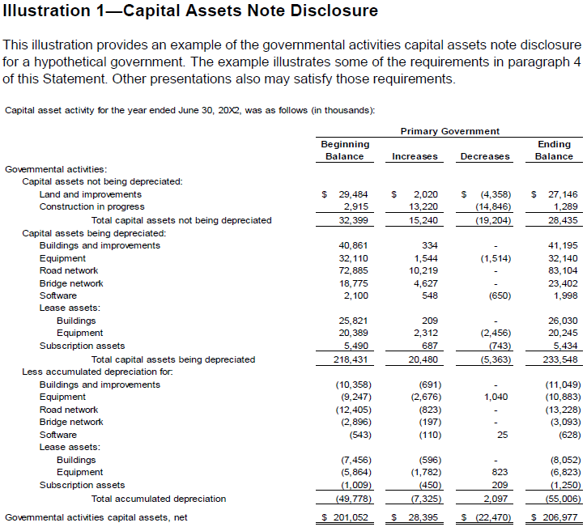
GASB 104 Illustration 1 – appendix c

Slide 107
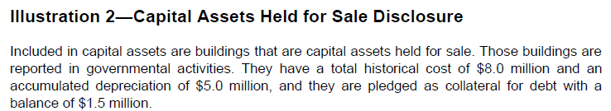
GASB 104 Illustration 1 – appendix c

Slide 108
Budget Monitoring

Slide 109



Presenters
Scott Catlett
Director – Government Advisory Services
Nashville, TN
Name, Designation
Title
Location
Shelby Burguan
Manager – Government Advisory Services
Vancouver, WA

Slide 110
Focus Areas for Today’s presentation
Budget Monitoring
Responding to variances
Interim Budget Reporting
Year-End Analysis and Action
Forecasting During Budget Monitoring

Slide 111
Monitoring Revenue and Expenditure Variances
Most agencies have a financial system that provides budget to actual data
Adopted budget.
Amendments (mid-year, carryover, etc.).
Encumbrances.
Year-to-date actual data.
Remaining budget balance.
Perhaps some simplistic trend analysis (straight line projection, etc.).

Slide 112
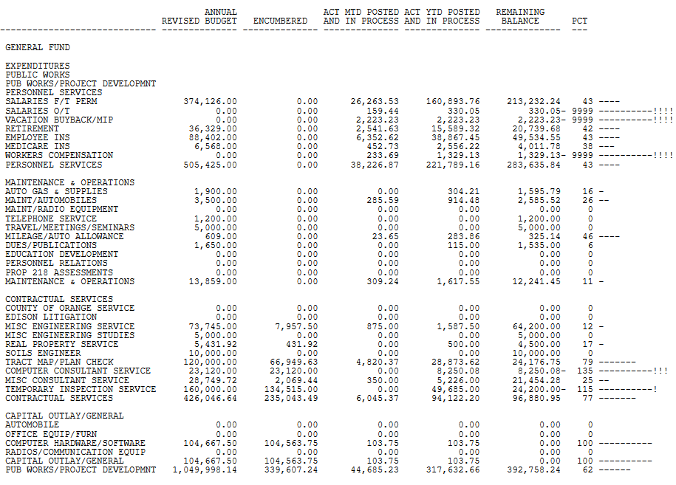
Sample Budget to Actual Report

Slide 113
Effective Monitoring
Effective monitoring starts with budget to actual data.
Agency-specific analysis that takes into account unique factors:
  Payroll cycle.
  Benefits payments (insurance, pensions, etc.).
  Account-specific circumstances (debt payments, large contracts, equipment purchases, etc.).
Absent budget projection software, complex Excel spreadsheets can be developed that take these issues into account.

Slide 114

WHAT IS THE APPROPRIATE FREQUENCY OF MONITORING?
Considerations:
  Size of organization.
  Complexity of organization.
  Staff resources.
  Revenue or expenditure volatility.
  Interest of elected officials and the public.

Slide 115
What Constitutes Periodic Monitoring?
Update of revenue projections
Reviewing original budget.
Adding unanticipated revenues.
Analysis of year-to-date expenditures
Budget-to-actual analysis.
Supplemental appropriations.
Projection of year-end results (including revenues, expenditures, and changes to fund balance)
Identification of significant variances or unknowns
What’s changed?
What’s been added to the budget?

Slide 116
Conducting A Budget Variance Analysis
Requires more than just running a report from your financial system:
  Beware of aggregation of variances (example: vacancy savings is offsetting overspending on materials).
  Expenditure savings may be tied to reduced revenue (example: dangerous building abatements).
  Additional revenue may be accompanied by higher spending (example: contract building inspection costs).
  Identify errors, correct them, and provide training to prevent recurrence.
Make sure that controls are in place to prevent overspending, but flexibility is maintained to operate efficiently:
  Expenditure control at the account group level with overrides requiring approval.
  Automated early warnings.
  Purchase orders require sufficient budget to be encumbered.
  Payments cannot be initiated without sufficient budget with overrides requiring approval.

Slide 117
Accounting for Encumbrances
Encumbrances recognize commitments of resources for future spending:
  Reflect the issuance of a purchase order or other commitment for the procurement of goods or services.
  Treated as if the funds have been expended (reduces available resources).
Monitoring encumbrances is a critical component of effective budget monitoring:
  When will encumbered funds be spent?
  What happens to unspent encumbrances as the end of the year (more on that later).
  Are there encumbrances that should be deleted (annual purchase orders, residual balances, etc.).

Slide 118
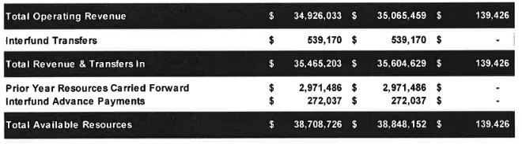
Understanding the “Total” Budget
Available resources:
  Current year revenue and transfers in.
  Prior year-end fund balance set aside to cover continuing appropriations and encumbrances.
  Other resources such as internal loan repayments.
Required resources:
  Current year expenditures and transfers out.
  Continuing appropriations and encumbrances.
  Mid-year budget adjustments.
  Other uses of funds such as new internal loans.
Impact of growth in the budget on minimum reserve balances dictated by financial policies.

Slide 119
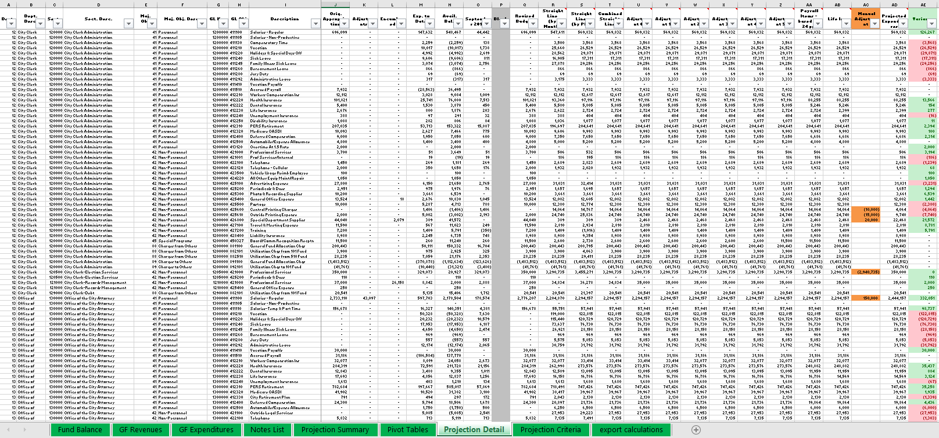
Sample Projection Spreadsheet
Formulas analyze certain account numbers differently to determine type of expenditure and make adjustments to projection methodology.
User makes manual adjustments for special circumstances.

Slide 120
Discussion Questions
Do your agencies monitor the budget throughout the year on a periodic basis?
1
Do your agencies conduct monitoring within the budget system or utilizing Excel-based tools?
2

Slide 121
Variance Analysis
Once you have a validated model in place to project expenditures, you have to effectively analyze budget variances.
Variance analysis:
  Analysis of differences between planned and actual spending.
  A threshold for significance should be established.
  Consider conducting variance analysis at a level other than the account level, at least initially.
  Automated systems may be able to produce exception reports to assist in identifying areas of concern.
  Beware of aggregation of variances.
Revenue and expenditure variances may be related:
  Expenditure savings may be tied to reduced revenue (example: dangerous building abatements).
  Additional revenue may be accompanied by higher spending (example: contract building inspection costs).

Slide 122

EXCEPTION REPORTS
An exception report highlights items in a population of data that are not “normal”.
For example:
  Payment requests from an account with an insufficient budget.
  Large payment requests.
  Accounts over budget by more than 5%.
  Payments over some amount that were not made against a purchase order (to see if expenditure is double counted).

Slide 123
Data Aggregation
Aggregation in financial analysis is the problem that occurs when multiple pieces of information, when combined, produce a misleading total variance.
This can lead to managers making incorrect decisions absent more detailed analysis.
In the example below, the total variance is minimal, but vacant position savings is masking a big problem with spending on materials.
 | Actual | Budget | Variance
Filled Positions | $ 896,345 | $ 900,000 | ($ 3,655)
Vacant Positions | $ 0 | $ 150,000 | ($150,000)
Total Salaries | $ 896,345 | $1,050,000 | ($153,655)
Materials | $ 873,227 | $ 725,000 | $ 148,227
Total Budget | $1,769,572 | $1,775,000 | ($ 5,428)

Slide 124
Allotment System
Controls the amount of the budget that may be spent within a specific time frame.
Example:
  Public Safety has a budget of $12 million.
  Each month $1 million will be available for spending.
  Amounts required above the allotment require justification.
Not frequently seen in practice and difficult / time consuming to manage.
Well-developed projections can somewhat mirror an allotment system to identify trends that are a cause for concern.

Slide 125
Preventing Overspending
What is the legal level of control for budgetary compliance?
  Budgets may not be exceeded at the fund and/or department level.
  Additional spending requires approval of the chief executive or governing body based on certain dollar limits.
What is the internal policy level of control for budgetary compliance?
  Budget transfers are only required for certain accounts (within non-personnel group, etc.).
What controls are in place to prevent exceeding budgets?
  Are there automated early warnings?
  Can new purchase orders be initiated without sufficient budget?
  Can accounts payable initiate payments without sufficient budget?
There should be a clear financial policy that covers all of this to set expectations
for end-users of the financial system.

Slide 126

Preventing Errors
Budget data and reporting are only reliable if the actual spending is recorded correctly:
  Monitoring and correcting account coding.
  Variance analysis.
  Ideally a set, periodic process to do this for the entire agency (or at least material areas of focus in the budget).
  Identification (and possibly retraining) of the source of the error.
This is a revenue and an expenditure issue – revenue can be recorded incorrectly as well:
  Example: coding of property tax receipts.

Slide 127
Responding to variances

Slide 128
The Nature of Projections
All budget analysis and projections in the monitoring process involve professional judgement and a degree of estimation:
  Projections must be thoughtful and based on sound analysis and decisions.
  Revenue analysis may benefit from the use of outside consultants.
  Bad projections can result in mid-year adjustments with negative impacts on services.
  Prolonged poor analysis or denial of budgetary realities can result in a drawing down of reserves and impacts to subsequent fiscal years.

Slide 129
Internally Responding to variances
Not all budget variances require formally amending
the budget
Internal responses from the budget office may suffice.
Contingency funds can be used to address some smaller concerns.
Positive revenue variances in one area may offset negative variances elsewhere.
Expenditure savings may offset other areas where spending currently exceeds or is projected to exceed the budget (if within the same legally-separate area of the budget).
When do you act?
Wait for actual spending to exceed budget.
Act on projections.
What variances are significant?

Slide 130
Balancing Methods
When a variances is identified, the budget office should immediately respond:
  Discretionary spending freeze.
  Temporary hiring freeze.
  Vacancy “stretching”.
  Redirection of funds budgeted for other purposes.
  Initiate a formal adjustment to increase the budget (requires the identification of new revenues or the use of reserves).
Different methods are required in situations of significant variance (recession, lost grants, etc.) such as layoffs, furloughs, or program reduction or elimination.
Decisions may or may not require governing body approval (often a political question more than a policy question).

Slide 131
Budgeted Contingency Funds
A line-item included in the budget to be used for unforeseen expenditures:
  Perhaps a set percentage of the budget or a set dollar value.
  Use may require governing body approval or be regulated through a policy with use at the discretion of the chief executive or budget office.
  May be expended directly or transferred to replenish line items in department budgets.
Can be difficult to include in the budget in lean budget times due to competition for scarce resources.
Can be quickly depleted if departments (or the budget office) become comfortable with using contingency funds frequently.

Slide 132

Taking Corrective Action
Identification of larger revenue shortfalls or expenditure overages may require formal corrective action:
  What caused the variance, and will it continue or be offset by future activity?
  Identification and correction of coding errors or misallocated staff.
If corrective action is required:
  Amending the revenue budget due to variances.
  Submitting and considering transfers or supplemental appropriation requests.
  Implementing or obtaining approval for program or service level reductions.

Slide 133
Formal Adjustment and Interim Approval
Amending the budget may require approval of the governing body or the chief executive, depending on the amount:
  Includes budget transfers if outside of the legal level of control for the agency (example: repurposing excess fire department funds for the police department).
  Transfers within the legal level of control typically are approved administratively.
  Some agencies require all amendments to be approved by the governing body, others delegate authority for smaller amendments to the chief executive or budget office.
Amendments should be tracked and reported to the governing body, regardless of the type of approval.

Slide 134

Interim Budget
Monitoring is a Team Effort
Finance as well as analytical staff and/or management in other departments must regularly monitor the budget for variances:
  Ideally, involve departments in the process if resources permit.
  Finance should ensure that departments recognize the impact of mid-year program and service level decisions on the budget.
  Example: quarterly meeting with each department to review variances as a team.
  Be seen as an ally in finding solutions, not just pointing out problems.

Slide 135
Forecasting During Budget MOnitoring

Slide 136
What is Forecasting?
DEFINITION
A forecast is a prediction concerning future conditions that are likely to affect an organization. A forecast identifies trends in external and internal historical data, and projects those trends.
Financial forecasting refers to the use of analytical techniques to produce estimates of future inflow of financial resources.

Slide 137
The Forecasting Process
Determine the scope of the needed forecasting.
Identify key drivers of the forecast and related issues such as volatility, seasonality, etc.
Gather required historical, current, and future information impacting the forecast.
Determine the best methods for forecasting the given data.
Prepare the initial forecast.
Conduct a sensitivity analysis.

Slide 138
Determine the Scope of the Needed Forecasting
Does this revenue source of expenditure category “matter” in the context of the overall budget?
How much time is appropriate to devote to this forecast?
Are there external sources that can be accessed to provide the needed information?
  Example: Property tax and sales tax consultant’s updated projections.
  Example: Convention Bureau or state data for transient occupancy tax trends.
  Example: Newly negotiated union contracts.
Is the revenue source or expenditure category subject to further volatility?
Is there information indicating the future trend will not match the past trend?
  Example: Sizable new development.
  Example: Changes to legislation.

Slide 139
Identify Key Drivers of the Forecast and Related Issues
To forecast effectively, one must understand the key driver(s) of the forecast for each line item or group of line items:
  Example: Latest trends in hotel occupancy to forecast transient occupancy tax revenues.
  Example: Newly-adopted utility rates to forecast utility expenses.
  Example: Recent changes to building permit activity.
Identify related issues:
  One-time items.
  Adjustments expected later in the fiscal year.
  External factors such as changes in consumer behavior.

Slide 140
Gather Information Impacting the Forecast
Historical and year-to-date data.
What are the patterns – linear, cyclical, accelerating, growing, shrinking, etc.?
Collect information about one-time items, items added or removed, etc. that may impact the trend:
  Example: New programs added or new sources of revenue coming online.
External information (as previously discussed).
Internal information:
  Example: Building permit data.
  Example: Contract services renewals.

Slide 141
Determine The Best Methods for Forecasting
There is no right answer as to what method will work the best.
Select the method that works best given the information available and remember that complex is not always better.
Determine whether your forecast can be:
Effectively prepared using qualitative techniques.
If not, employ quantitative techniques.
If necessary, determine the appropriate quantitative forecasting methodology.

Slide 142
Qualitative Forecasting
Forecasting based on your own expertise, known information, or expert insights:
  Best for When there is clear information that does not require further (or much) analysis.
  Example: utilizing a forecast provided by an industry expert or government agency.
  Example: increasing the budget for a large contract based on new contract negotiations.
  Example: using building permits data provided by Planning staff to forecast building permit revenue.
Advantages – it’s fast and someone else has provided the support.
Disadvantages – may be influenced by external or internal pressures and someone else has provided the support.

Slide 143
Quantitative Forecasting
Forecasting based on data trends and analysis:
  Best for When there is historical data that is well understood.
  Example: trend analysis of business license tax revenues by month.
  Example: trend analysis of health insurance rates based on new information.
Advantages – it’s based on historical information and your own thorough analysis.
Disadvantages – without a full understanding of the future, historical information may not be a good indicator of future trends.
Many forecasts blend both methods to enhance accuracy:
  Example: Adjusting an expert’s forecast to account for known information such as new businesses or closing businesses.

Slide 144
Prepare the Forecast and Conduct a Sensitivity Analysis
Prepare the initial forecast.
Test the reasonableness of the assumption by conducting sensitivity analysis.
Examine a range of different assumptions based on historical variability.
Example: Building permits revenue trends:
  Pessimistic: Year-to-date drop accelerates.
  Expected: Year-to-date drop continues.
  Optimistic: Return to original budget asumptions.

Slide 145
Discussion Questions
Does your agency analyze year-to-date data and adjust the budget based on forecasting expected trends?
1
Are there changes that you might consider making to your existing forecasting methodologies?
2

Slide 146
Interim Budget Reporting

Slide 147
Interim Budget Reporting
Can be real-time using financial systems (not reconciled, analyzed, or verified).
Can be done on a periodic basis with review and analysis (monthly, quarterly, or semi-annually).
Real-time reports are typically for management and at a line-item level of detail.
Periodic reporting is typically for senior management and elected officials with limited detail and a variety of summarization:
  Built from the data found in budget office projections.
  Supplemented by narrative analysis of actual and projected variances.

Slide 148
Formalized Periodic Reporting
Decide on the frequency of reporting:
  The frequency of monitoring need not be the same as the frequency of reporting.
  At a minimum, a mid-year review should be conducted.
  As a best practice, quarterly reviews are better.
  Monthly internal reviews may be helpful, but may not yield additional results to justify the effort in all but the largest agencies.
  Report year-end budget results with, or separately from, presentation of the financial statements.
Decide on the method of reporting:
  Will the report(s) go to your governing body, and if so on consent or as a discussion item?
  Do you have a Finance Committee? If so, will they review prior to or in lieu of the governing body?
  If monthly internal reviews are conducted, will they be shared with executive management?

Slide 149
Projections Change, and that’s ok!
 | First Quarter | Second Quarter | Third Quarter | Fourth Quarter
Projected Revenues | $35,265,000 | $35,465,000 | $34,865,000 | $35,000,000
Projected Expenditures | ($34,817,000) | ($34,617,000) | ($35,143,000) | ($34,743,000)
Change in Reserves | $448,000 | $848,000 | ($278,000) | $257,000
Projected Ending Reserves | $15,672,000 | $16,072,000 | $14,946,000 | $15,481,000
Keep in mind that projections are not certain.
Interim reporting is no different than long-term financial planning.
It is OK to revise as the year progresses.
Prepare your audience for this and explain the why.

Slide 150
Key components of Interim Budget Reports
Summary projections at the fund level for agency’s “major” funds with budget versus projected actual data:
  Revenue.
  Expenditures.
  Fund balance.
Other frequently-included elements:
  Narrative data about trends.
  Should clearly highlight material variances without providing too much unnecessary detail.
  Information on changes to the budget to date initiated by management or the governing body.
  Recommendations for any required corrective actions to address variances.

Slide 151
Key components of Interim Budget Reports
The General Fund (or primary enterprise fund(s)) should be thoroughly analyzed.
What about other funds:
  Which funds matter?
  Are they analyzed on the same frequency as the General Fund?
  Is reporting done at the same level of detail for all funds?
  How much information is too much?
Will your report include a summary or the details?
  It is the accuracy of the report that matters, not necessarily what is reported.
  Gauge the appetite of the recipients of the report for detail.
  Don’t just report on year-to-date – project what is likely to happen through the remainder of the year.
  If you report year-to-date, does that information have context?

Slide 152
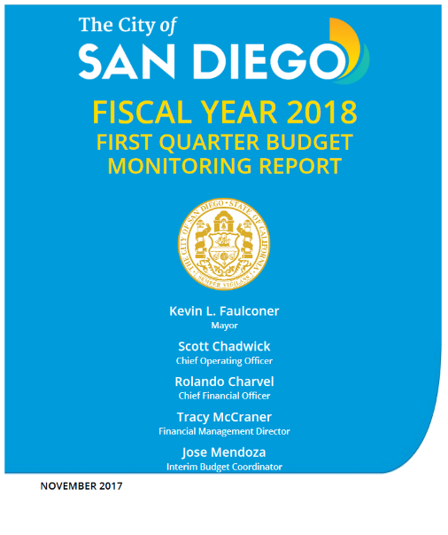
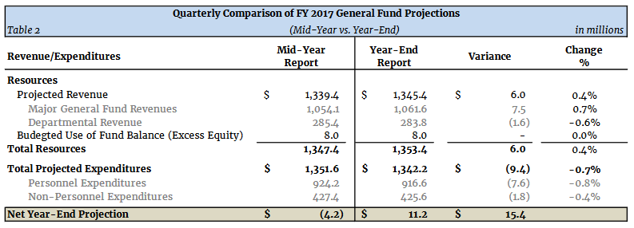
Sample Interim Budget Report
The City of San Diego produces a complex quarterly budget report.
Reports can range from a single summary table accompanying a staff report to large reports with detailed analysis:
  Accuracy of projections is key.
  Explanation of variances as the year progresses will be required.

Slide 153
Year-To-Date Versus Projected Actuals
Year to date information can be useful with context.
Many agencies fail to provide that context, and without it this information can be more confusing than helpful.
A discussion of projected actuals provides much more useful information because it is directly comparable to the adopted or amended budget for the current year, not a prior year.
Thinking through the reasons for year-to-date variances rather than just reporting the numbers can also lead to a better understanding of projected year-end actuals.

Slide 154
Year-End Analysis and Action

Slide 155
Year-End Budget Reporting
Final year-end results are presented in the Annual Comprehensive Financial report (ACFR):
  The ACFR presents budget to actual and financial statements in compliance with generally accepted accounting principles.
  ACFR reporting is standardized across all agencies.
  Budget reporting varies from agency to agency.
Presenting final budget to actual information on a budgetary basis to the governing body and senior management in addition to the ACFR can be beneficial:
  Easy to understand if consistent format used.
  Clearly highlights variances.
  Indicates impact of results on fund balance.
  Makes recommendations for utilizing any surplus.
  Discusses implications of any deficit.

Slide 156
Disposition of budget Surpluses
In times of economic expansion, surplus funds will often be available at year-end:
  Can be mitigated with a vacancy factor or “managed savings”.
Encumbrances and capital projects typically carry forward.
Options for what happens to other surplus funds:
  Appropriations lapse.
  All or a portion of the surplus is carried forward to the next fiscal year (example: savings incentive program).
  Consideration of specific requests for the carryover of funds.
  Reprogramming of funds for other purposes (examples: unfunded liabilities, deferred capital projects, etc.).
There should be a formal, policy-driven process for managing year-end surplus funds (often part of a reserve policy).

Slide 157
Discussion Questions
What information do you provide to your City Council or Board at year-end regarding budget to actual data?
1
Does your agency present this information concurrently with the financial statements or separately?
2

Slide 158

QUESTIONS?

Slide 159
Thank You!
Paul Kane, CPA
Partner, Assurance Services
pkane@eidebailly.com
303.459.6758
Jill Morasko, CPA
Manager – Assurance Services
jmorasko@eidebailly.com
406.896.2402

