Slide 1
Leadership & Management Skills Development
Hiring • Accountability • Engagement
Notes:
Welcome everyone. Today we’ll look at three pillars of effective leadership: hiring, accountability, and engagement. In just 30 minutes, I’ll share practical tools you can apply immediately.

Slide 2

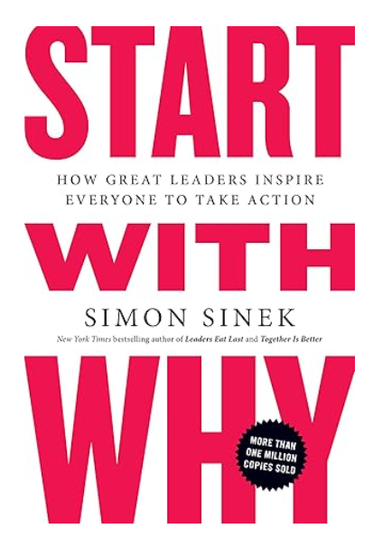
Leadership books

Slide 3
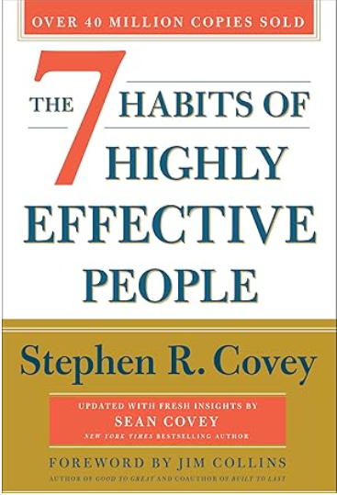
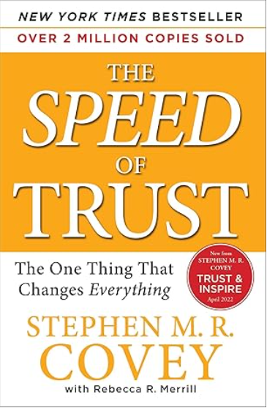
Leadership books

Slide 4
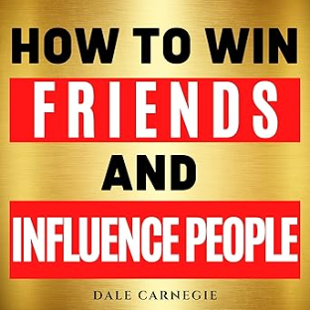
Leadership books

Slide 5


Why Leadership Matters
People join organizations, but they leave managers.
Leadership drives culture, performance, and retention.
Notes:
Leadership isn’t about titles. It’s about how you build trust, clarity, and growth. Strong managers improve retention, weak ones push talent away.

Slide 6
Hiring/Recruitment: Start with Clarity
Define the role by outcomes, not just tasks.
Identify 3–5 must-have values/competencies.
Arvada
  Innovation, Passion, Opportunity, Safety, Customer Service
Notes:
When roles are vague, mismatches happen. Start with clarity: 'What will success look like in 6 months?' Hire for fit/potential + values, not just technical skills.

Slide 7

Hiring/Recruitment: Tools
Structured interviews: ask every candidate the same questions.
Onboarding: create a 30-60-90-day integration plan.
Notes:
Consistency reduces bias and improves hiring decisions. A strong onboarding plan ensures new hires feel supported and productive fast.

Slide 8
Accountability: Set Expectations
Use SMART goals: Specific, Measurable, Achievable, Relevant, Time-bound.
Connect goals to strategic plans
Notes:
Clarity is kindness. People can’t meet expectations if they don’t know them. SMART goals give structure and alignment.

Slide 9
Accountability: Feedback
Weekly/Monthly check-ins > annual reviews.
Provide Feedback & Support
SBI model: Situation – Behavior – Impact
BOOST model: Balanced – Observed – Objective – Specific - Timely
Notes:
Feedback works best when it’s regular and specific. The SBI model keeps it factual and reduces defensiveness.
1. SBI Model (Situation – Behavior – Impact)
Situation: Describe the specific event or context.
Behavior: Explain the observable action or behavior.
Impact: Share the effect it had on others or the outcome.
🟢 Example: “In yesterday’s team meeting (Situation), you interrupted others several times (Behavior), which made it hard for them to share their ideas (Impact).”
2. BOOST Model (Balanced – Observed – Objective – Specific – Timely)
Balanced: Include both positive and constructive feedback.
Observed: Focus only on what you’ve actually seen or heard.
Objective: Keep emotion and judgment out of it.
Specific: Provide clear examples.
Timely: Deliver feedback soon after the event.

Slide 10
Engagement: Why It Matters
Engaged employees = higher performance + lower turnover.
Engagement is more than perks—it’s purpose, recognition, value and growth.
Notes:
Engagement happens when people feel valued and see a future with the organization.

Slide 11
Engagement: Tools
Recognize often: praise in public, coach in private.
Ask quarterly: “What energizes you at work?”
Provide growth opportunities (stretch assignments)
Own the results
Arvada Recognition example – Innovation, Passion, Opportunity front wall, picture, gift card (best part is that the employees recognize each other)
Notes:
Engagement is personal. Show you care by listening, recognizing, and investing in your team’s development.

Slide 12

Integrated Leadership
Hire/Recruit with intention.
Set clear expectations.
Recognize and grow your people.
Notes:
These three areas connect—strong hiring builds the foundation, accountability drives performance, and engagement keeps people motivated.

